Slide 1
Summary of Twitter Sentiment Analysis
Starbucks Web 3 NFT – positive sentiment very high- Starbucks is investing to improve the engagement with the customers – slide 11 for detailed info – a good way to keep engaging with customers
Starbucks Online order- less positive review- small sample size- so need to investigate more. So explored mobile ordering
Starbucks Mobile ordering- positive sentiments- backed by the data- starbucks has the most mobile payment users- further, more than the quarter of revenue is through app (mobile order)– Good for company to keep on investing on the online ordering
Starbucks Rewards- very high positive sentiment- a good way to interact and engage with consumers- keep working on it
Starbucks robot- starbucks is introducing robots as barista- negative sentiment- as consumer don’t want a robotic barista
Café x and @getcafex– shows positive sentiments, however same might not be true for robotic barista at starbucks- good question to ask in interview or survey

Slide 2
Starbucks Investment
https://stories.starbucks.com/press/2022/starbucks-enters-new-era-of-growth-driven-by-an-unparalleled-reinvention-plan/
Starbucks growth plan:
https://investor.starbucks.com/press-releases/financial-releases/press-release-details/2022/Starbucks-Enters-New-Era-of-Growth-Driven-by-an-Unparalleled-Reinvention-Plan/default.aspx
https://www.theverge.com/2020/10/30/21540908/starbucks-app-q4-earnings-mobile-payments

Slide 3

Sales of selected leading coffee house and cafe chains in the United States in 2021 (in million U.S. dollars)
Leading chain coffee house and cafe sales in the U.S. 2021
Sales in million U.S. dollars
Note(s): United States; 2021
Further information regarding this statistic can be found on page 8.
Source(s): Technomic; Restaurant Business; ID 919774
2
This statistic shows the sales of selected leading coffee house and cafe chains in the United States in 2021. Starbucks topped the ranking, accounting for sales of approximately 24.56 billion U.S. dollars in the U.S. in 2021.

Slide 4
Number of units of selected leading coffee house and cafe chains in the United States in 2021
Number of units of selected leading coffee house and cafe chains in the U.S. 2021
Number of units
Note(s): United States; 2021
Further information regarding this statistic can be found on page 8.
Source(s): Technomic; Restaurant Business; ID 920174
2
Starbucks had 15,450 units in the U.S. in 2021, making it the leading coffee house and cafe chain in the United States in terms of units. Dunkin' Donuts and Tim Hortons followed in the ranking with 9,244 and 637 units, respectively.

Slide 5
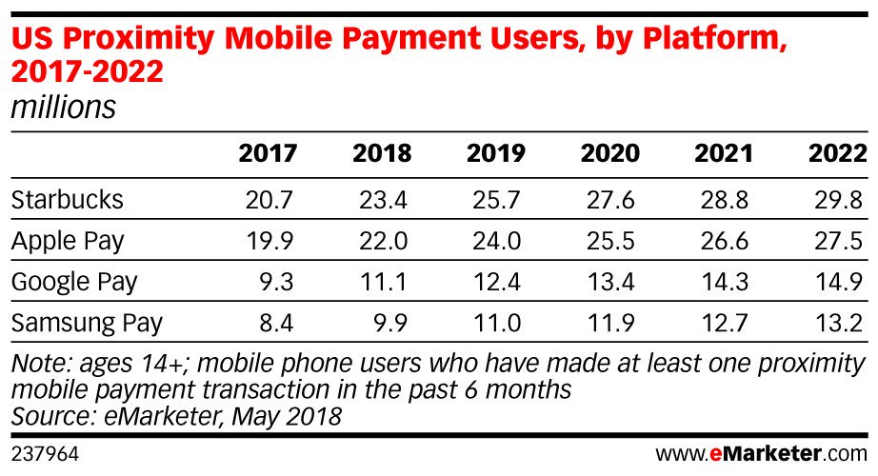
Starbucks mobile app: Mobile Payment Users vs Other payment platforms

Slide 6
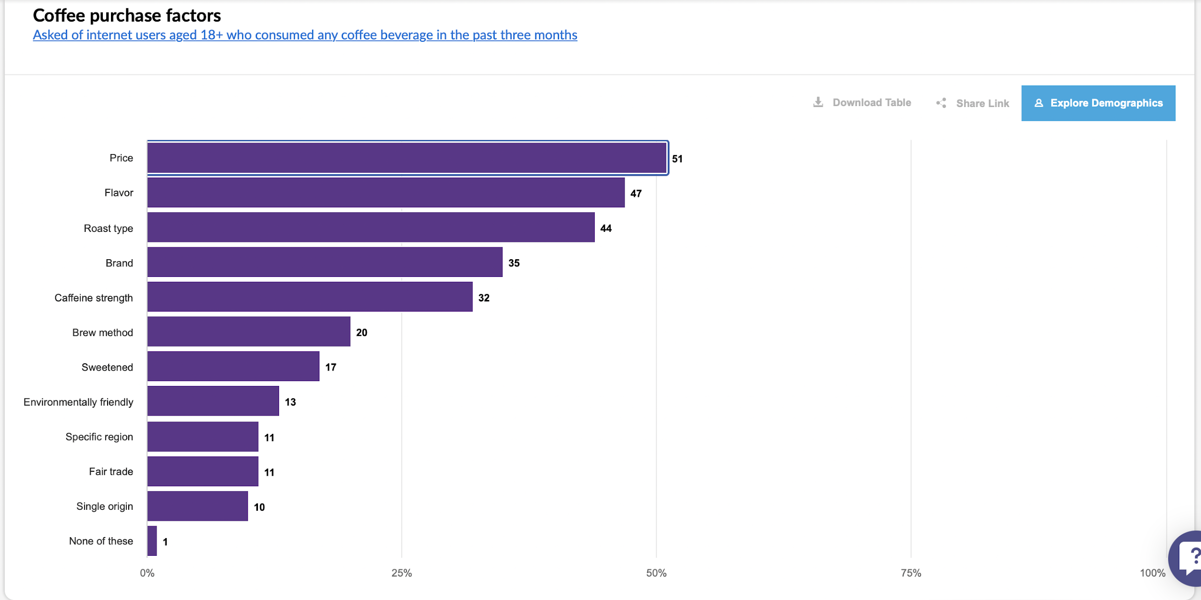
Coffee Purchase Factors

Slide 7
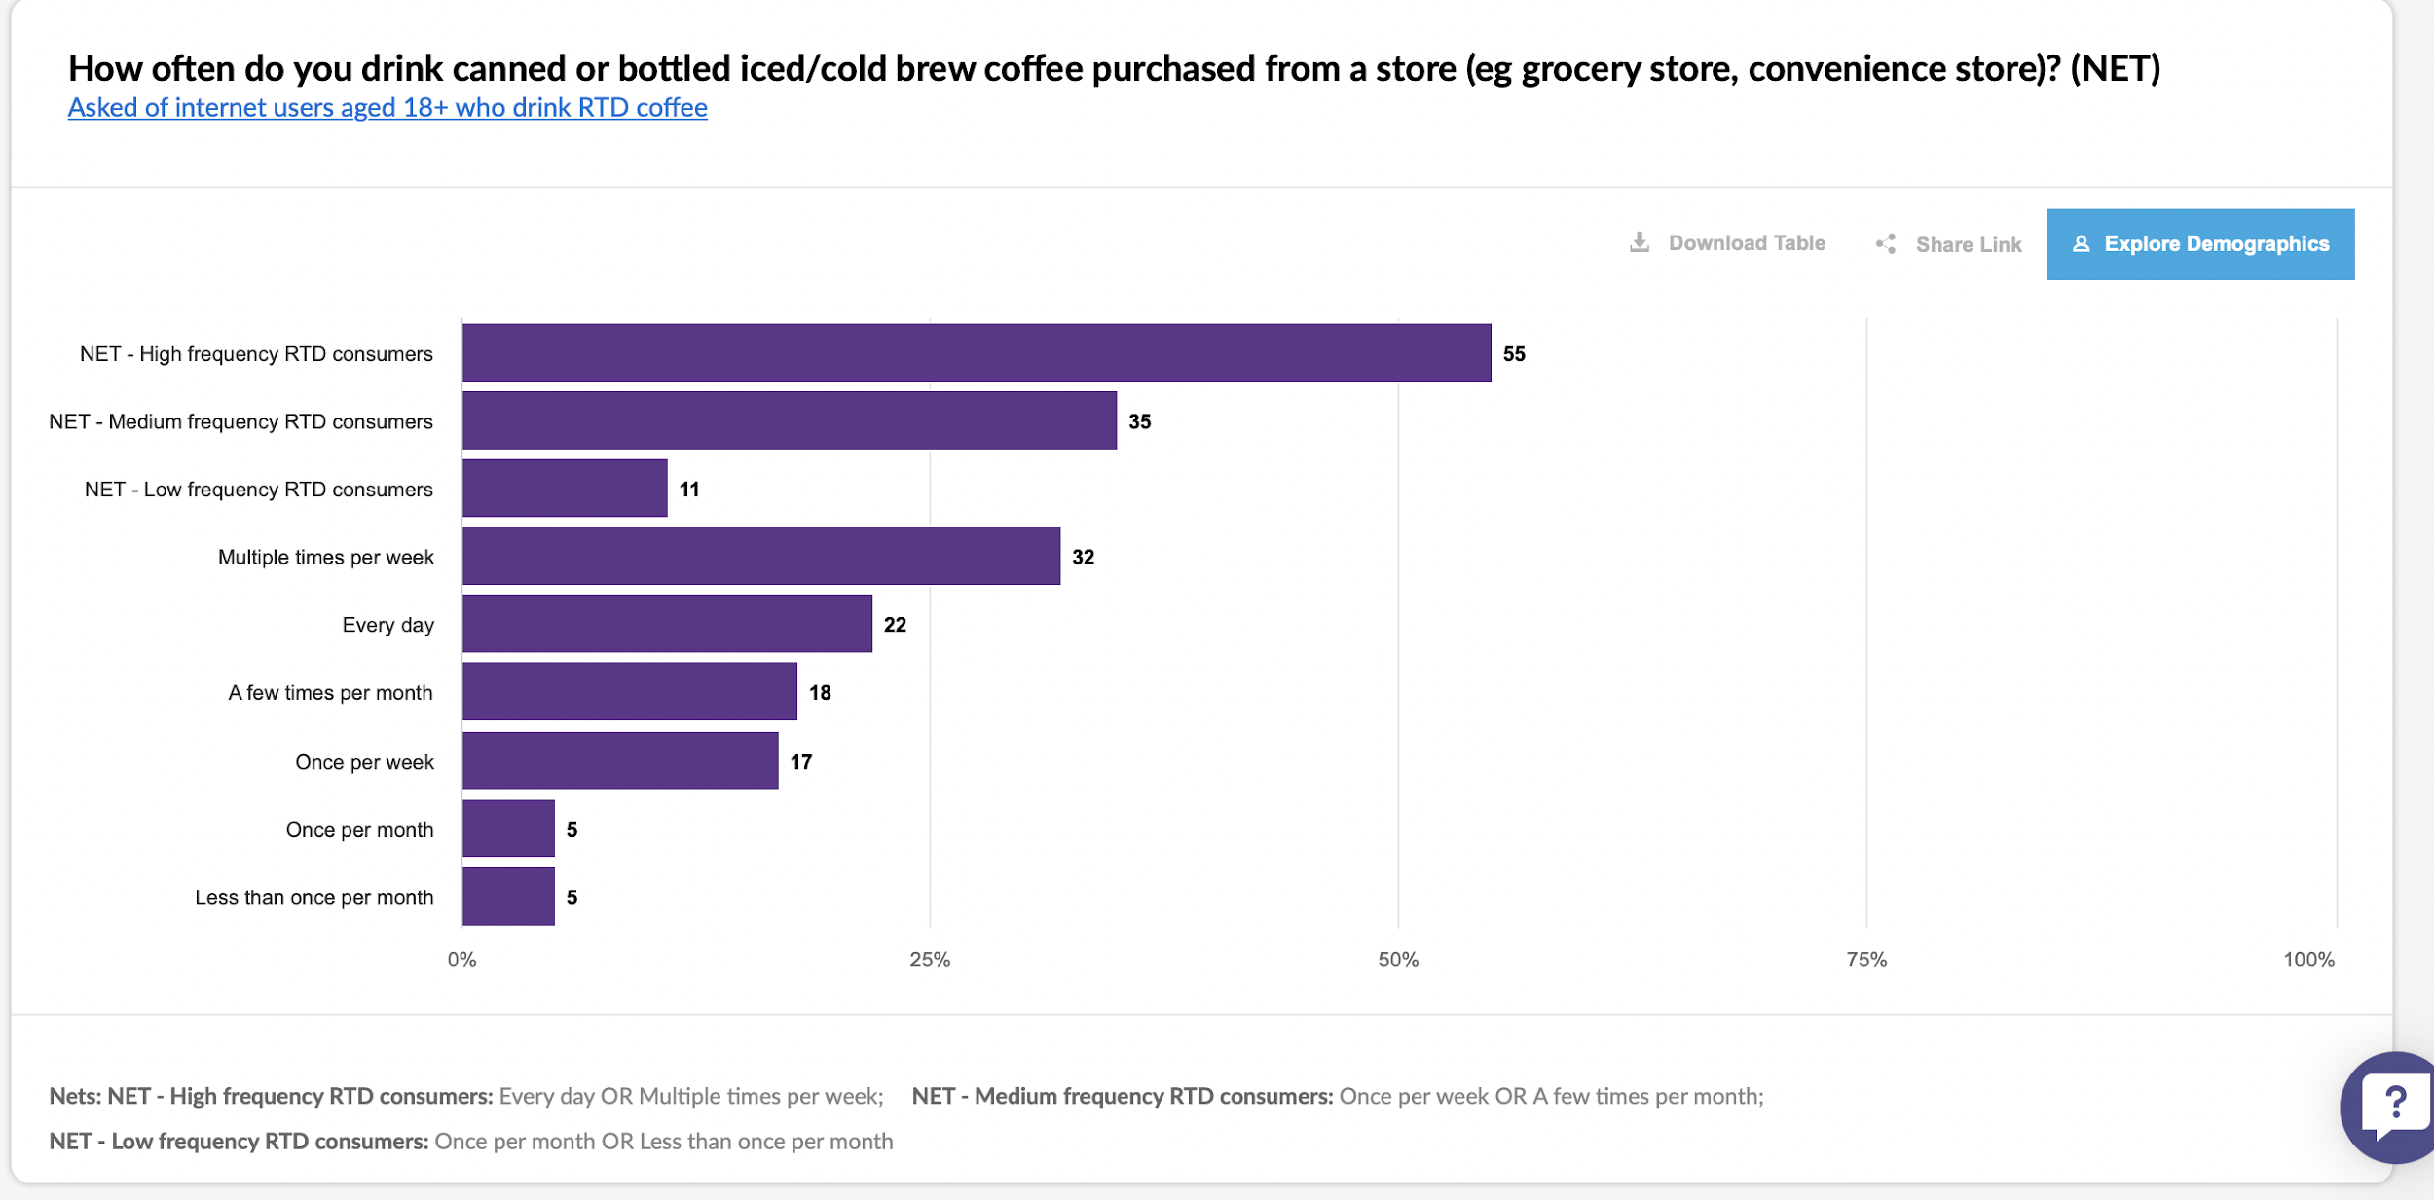

Slide 8
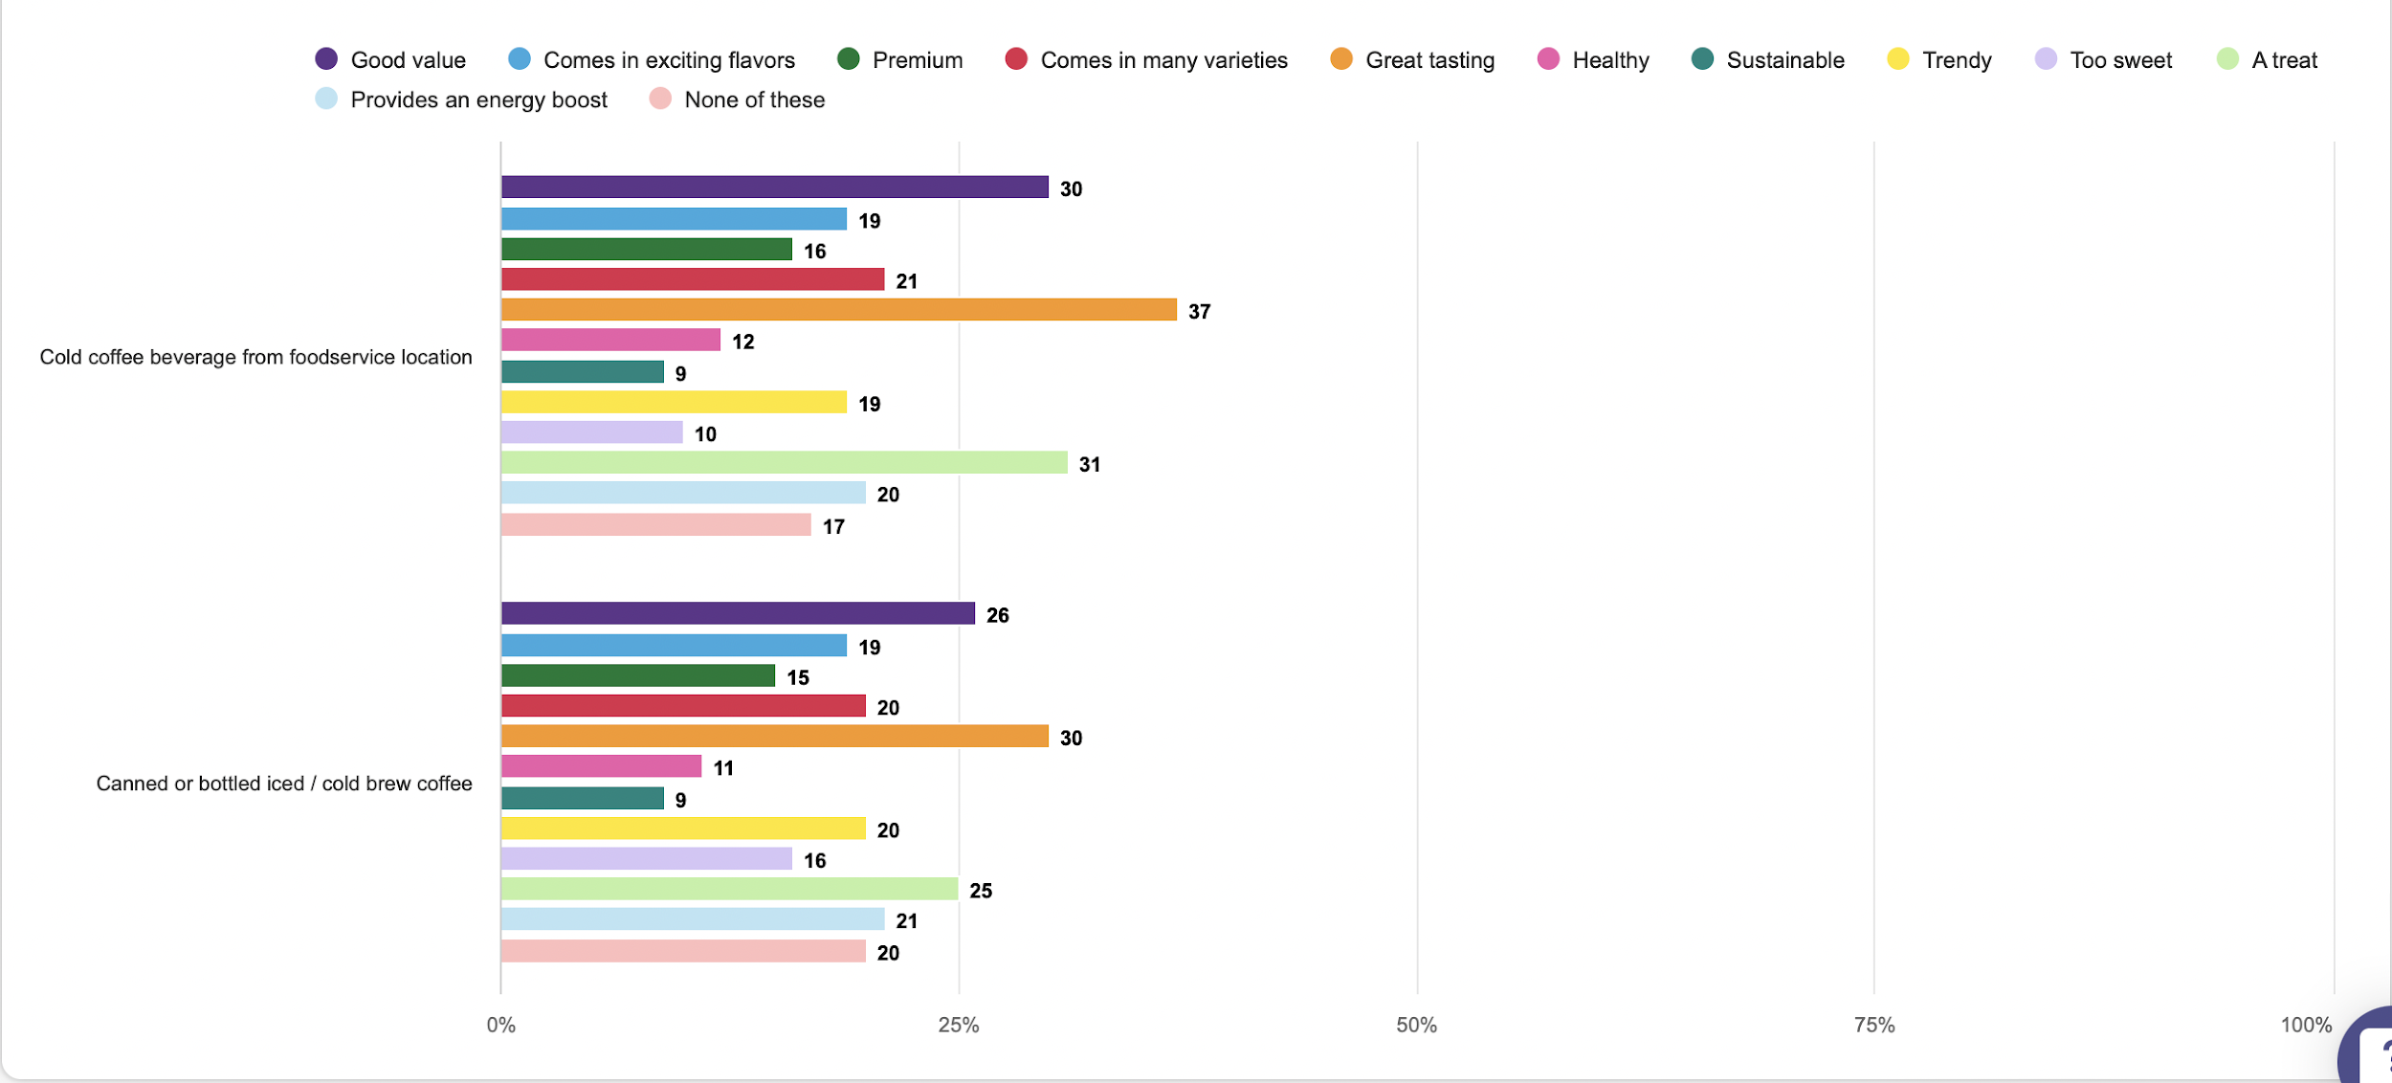
Association by coffee type
Asked of internet users aged 18+ who purchase coffee beverages from a foodservice location or consumed coffee in the past three months

Slide 9
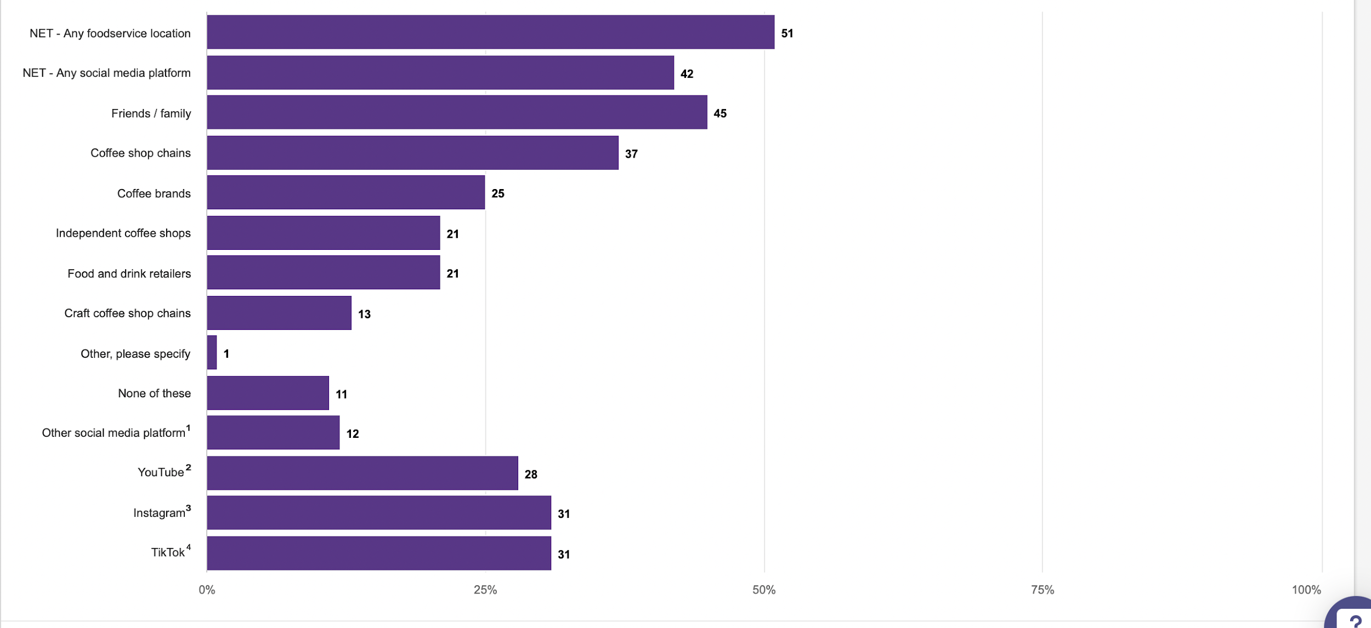
Where do you learn about coffee and coffee topics (eg new coffee drinks, recipes, coffee sustainability, brewing tips)? Please select all that apply. (NET)
Asked of internet users aged 18+ who consumed any coffee beverage in the past three months
Nets: NET - Any foodservice location: Coffee shop chains OR Craft coffee shop chains OR Independent coffee shops;
NET - Any social media platform: YouTube OR Instagram OR TikTok OR Other social media platform
¹
1,607 internet users aged 18+ who consumed any coffee beverage in the past three months and use any social media platform
²
1,492 internet users aged 18+ who consumed any coffee beverage in the past three months and use YouTube
³
1,134 internet users aged 18+ who consumed any coffee beverage in the past three months and use Instagram
⁴
915 internet users aged 18+ who consumed any coffee beverage in the past three months and use TikTok

Slide 10

Enginius Sentiment Analysis
Tweets- Starbucks Web3 NFT
Vaibhav Singh, UNIVERSITY OF SOUTHERN CALIFORNIA
Copyright (c) 2022, DecisionPro Inc.

Slide 11
Starbucks Brewing Revolutionary Web3 Experience for its Starbucks Rewards Members
“New Starbucks Odyssey experience will offer members the ability to earn and buy digital collectible stamps (NFTs) that will unlock access to new, immersive coffee experiences
As one of the first companies to integrate NFTs with an industry-leading loyalty program at scale, Starbucks will create an accessible Web3 community that will enable new ways to engage with members and partners (employees)”
Building Starbucks Odyssey using technology that aligns with Starbucks sustainability aspirations and commitments is a top priority. Starbucks is committed to reducing its carbon, water and waste footprints and is taking a thoughtful and thorough approach as the company works towards the launch later this year. Starbucks will utilize a “proof-of-stake” blockchain technology built by Polygon, which uses less energy than first generation “proof-of-work” blockchains
https://stories.starbucks.com/press/2022/starbucks-brewing-revolutionary-web3-experience-for-its-starbucks-rewards-members/
https://risnews.com/starbucks-hires-cto-investing-workforce-tech-and-nfts

Slide 12
Tweets used in the analysis (excerpt)
 | Date | Source | Tweet
1 | 2022-10-13 | Twitter for iPhone | Web3 Rundown_-@Starbucks joins the cool club with their Odyssey NFT loyalty program @StarbucksNews _-@TMobile x @helium create a cryptocarrier_-@FortniteGame Creator’s @EpicGames Store Launches First NFT Game
2 | 2022-10-13 | Twitter for Android | Starbucks Odyssey : tout savoir sur le projet #Web3 et #NFT du roi du café https://t.co/XU4fpVALgK via @lebigdata_fr
3 | 2022-10-13 | Twitter for iPhone | いつの間にかWeb3、という時代が近づいてきてます😆ポイントもブロックチェーンへ。__『Starbucks Odysseyの「スマートデザイン」志向。NFTを感じさせないUI/UXは今後の本流』～【新しいweb3ビジネスのアイディアのタネ】2022.10.13｜モリプト タツヤ @morika_wa #note https://t.co/S8Cao3YuSL
4 | 2022-10-13 | Twitter Web App | @Starbucks , rolled out Starbucks Odyssey, an #NFT marketplace which is also powered by #Polygon to upgrade its brand loyalty program in a #Web3 manner.
5 | 2022-10-13 | Twitter for iPhone | Ada projek NFT bagi free Starbucks. Ada projek NFT bagi free G-Shock. __NFT korang bagi apa kat holders? __#FYP #NFT #Blockchain #Starbucks #GShock #Crypto #Web3 #DDYHDNFT __@Daddyhood___ https://t.co/6EjsDqqKrK
6 | 2022-10-13 | Twitter Web App | 🥃Starbucks Odyssey : tout savoir sur le projet #Web3 et #NFT du roi du café https://t.co/eBW7cpuJV0 via @lebigdata_fr #Metaverse #Digital #Transfonum
7 | 2022-10-13 | Twitter Web App | 『Starbucks Odysseyの「スマートデザイン」志向。NFTを感じさせないUI/UXは今後の本流』__■スタバのNFT戦略を大手企業が注目する理由【コラム】_■スマートデザインとは？_■NFTのスマートデザイン的導入を周到に計画_■#web3 や #NFT のスマートデザイン化は今後広がる__https://t.co/pDtFiNxrC9
8 | 2022-10-12 | Twitter for iPhone | 「視覚に障害があっても使えるPOS(レジ)」は夢がある。顧客にブロックチェーンもWeb3もNFTもDAOも意識させないDXに拘っているのも是非実現させて欲しい。__Starbucks Corporation - Starbucks 2022 Investor Day https://t.co/xIcagep3Xc
9 | 2022-10-12 | Twitter for iPhone | With Chipotle and Starbucks leading the way with web3 initiatives, it’s about time McDonalds joined in on the fun as well! 🍟🍟🍟__@McDonalds Here’s what your NFT marketing campaign could look like: https://t.co/q3wu1Z3nCK
10 | 2022-10-12 | Buffer | ☕️ Can Starbucks bring Web3 into the mainstream?_https://t.co/FFr2yCrm1v _ #nft

Slide 13
Word cloud

Slide 14
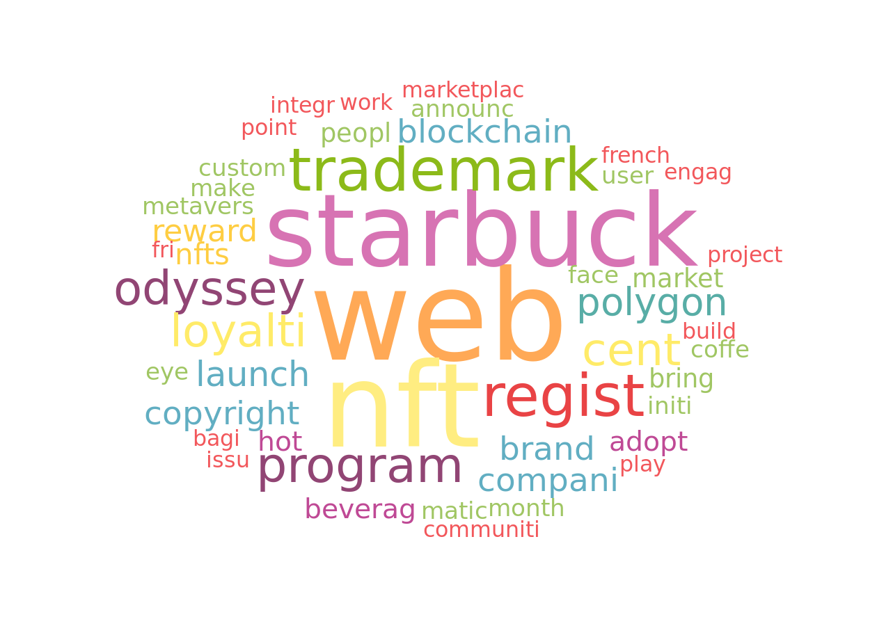
Word cloud
The word cloud represents the most frequently used words inside the corpus of texts provided. The bigger a word appears, the larger the number of times it occurs in the text corpus.

Slide 15
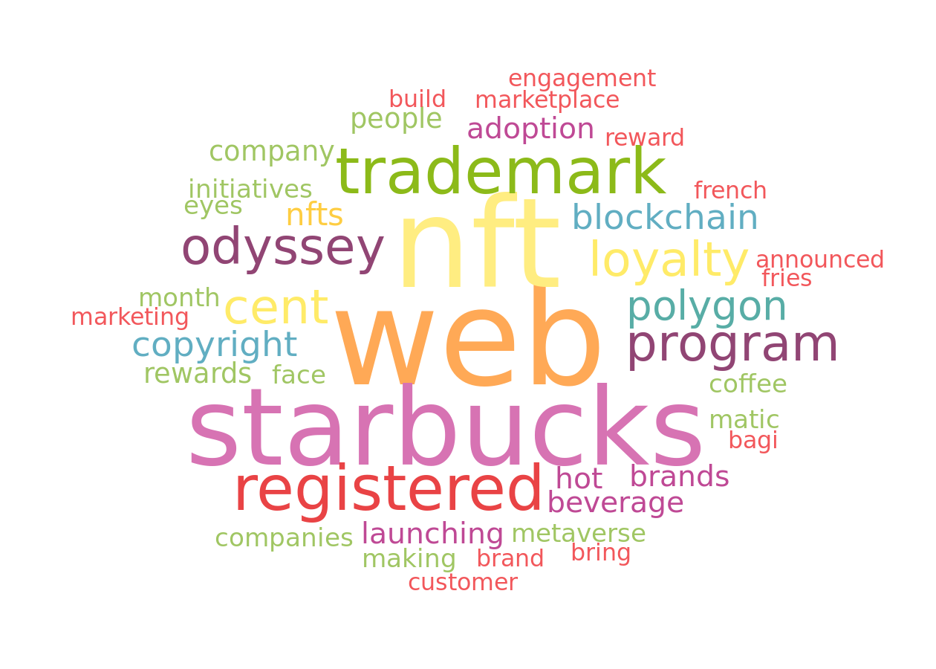
Word cloud without stemming
The word cloud represents the most frequently used words inside the corpus of texts provided. The bigger a word appears, the larger the number of times it occurs in the text corpus.

Slide 16
Valence analysis

Slide 17
Valence repartition
 | Posts count | Relative posts count
Total | 50 | 100%
negative | 8 | 16%
neutral | 9 | 18%
positive | 33 | 66%
The number of posts that fall into different valence categories summarized by their absolute and relative values.

Slide 18
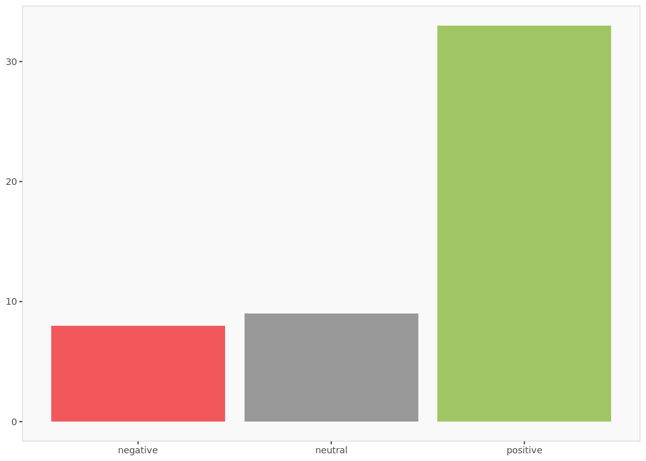
Valence histogram
The valence histogram indicates the number of posts by their valence.

Slide 19
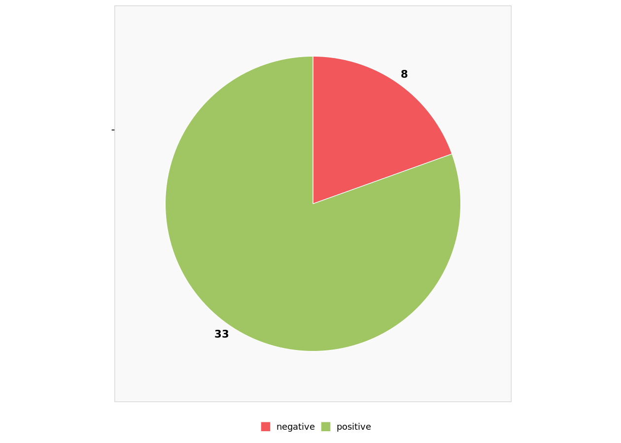
Valence distribution without uncategorized posts
Graphic summary of the relative sizes of the number of posts classified by valence after ignoring posts that could not be categorized (i.e., neutral posts).

Slide 20
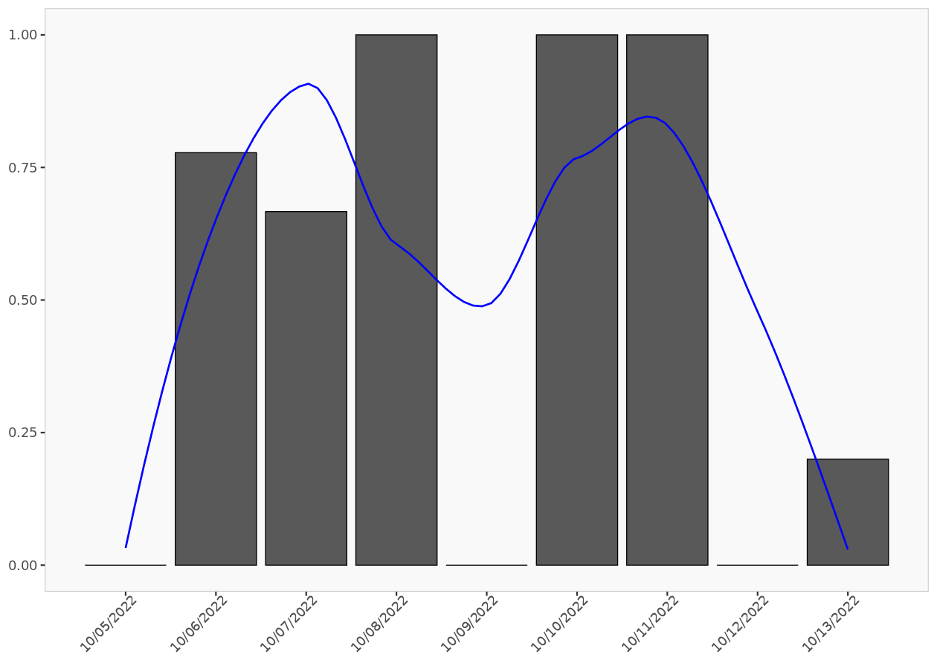
Post valence ratio
The post valence ratio graph indicates the daily average number of positive posts. The blue smoothing line helps visualize the trend.

Slide 21
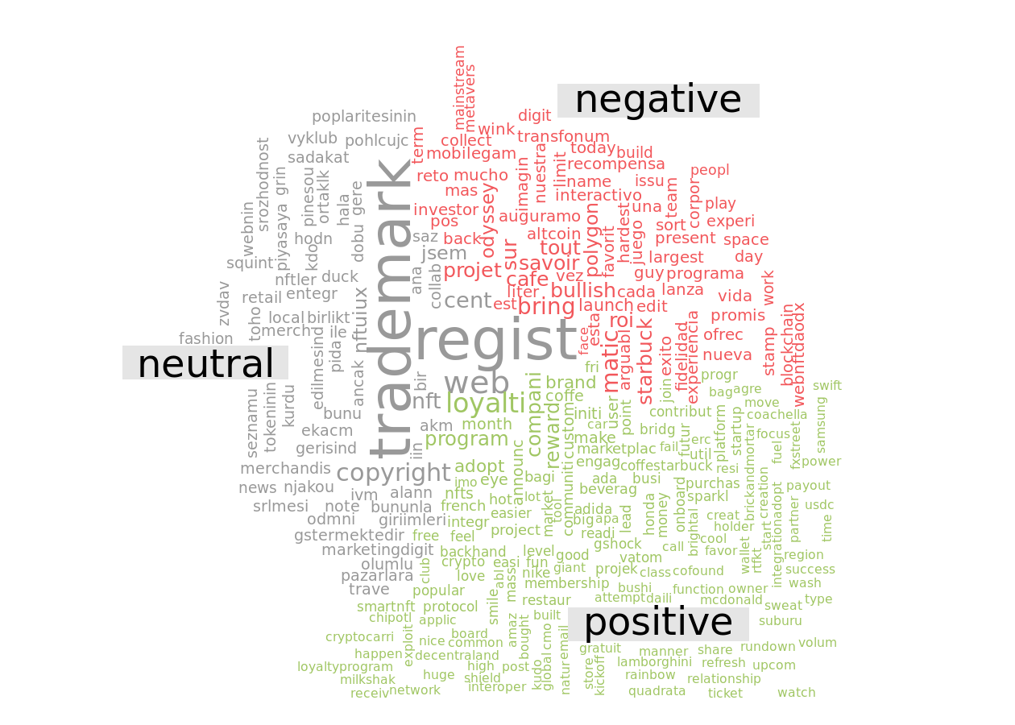
Valence word cloud

Slide 22
Emotion analysis

Slide 23
Emotion repartition
 | Posts count | Relative posts count
Total | 50.00 | 100%
anger | 5.78 | 12%
anticipation | 6.87 | 14%
disgust | 2.58 | 5%
fear | 3.25 | 7%
joy | 6.53 | 13%
sadness | 2.58 | 5%
surprise | 2.53 | 5%
trust | 19.87 | 40%
The number of posts that fall into different emotion categories summarized by their absolute and relative values. If a post has multiple emotions, then it is equally divided among those emotions.

Slide 24
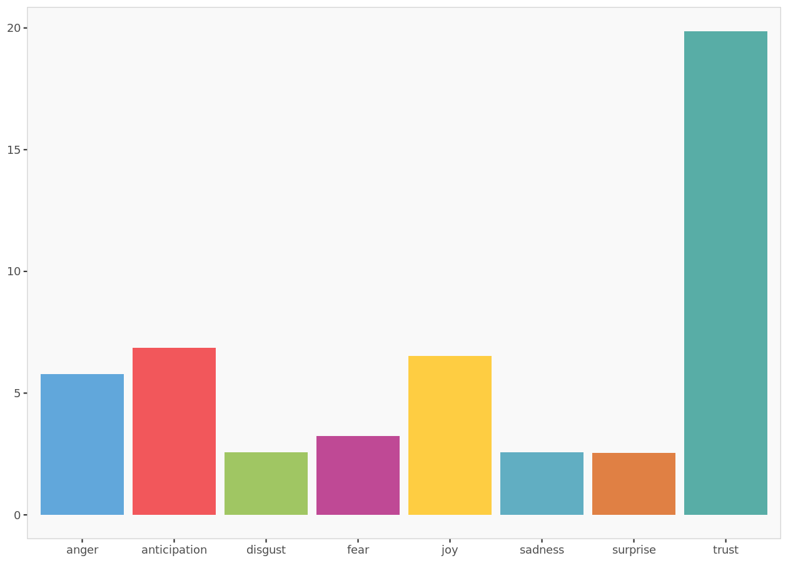
Emotion histogram
The emotion histogram indicates the number of posts by their emotion.

Slide 25
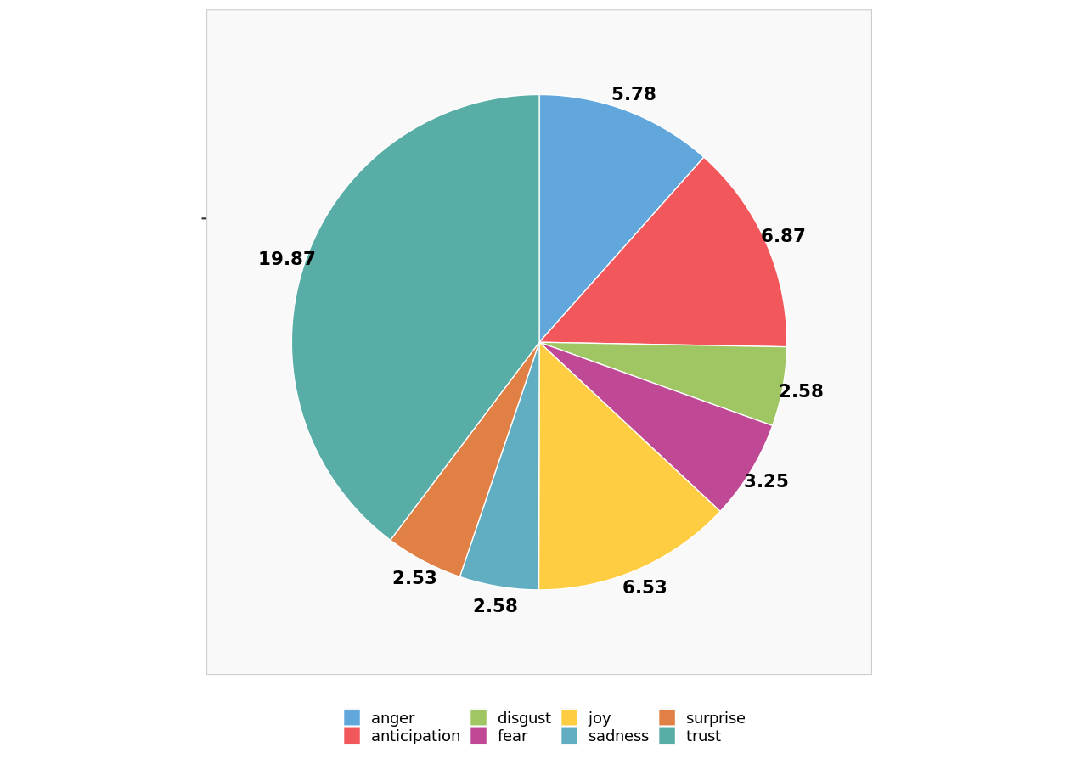
Emotion distribution without uncategorized posts
Graphic summary of the relative sizes of the number of posts classified by emotion after ignoring uncategorized posts.

Slide 26
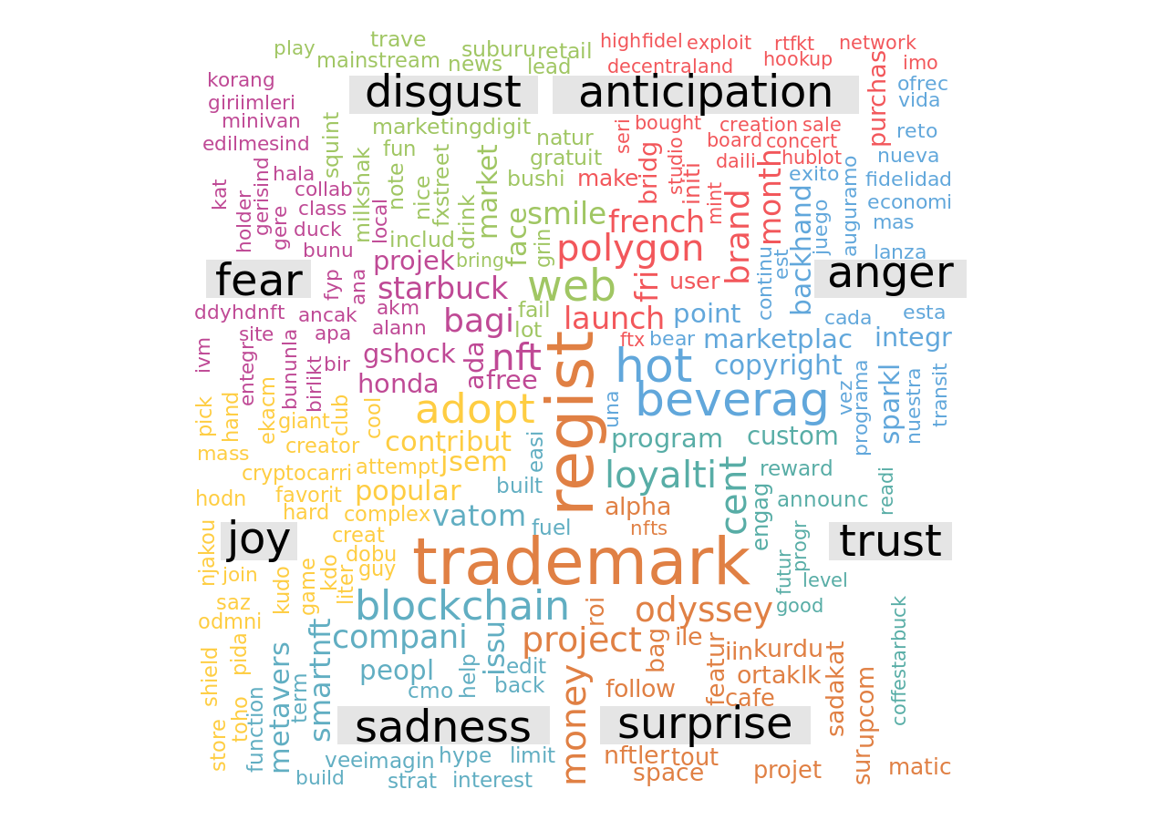
Emotion word cloud
Even if a post has multiple emotions its words will be shown only in one of those emotions.

Slide 27
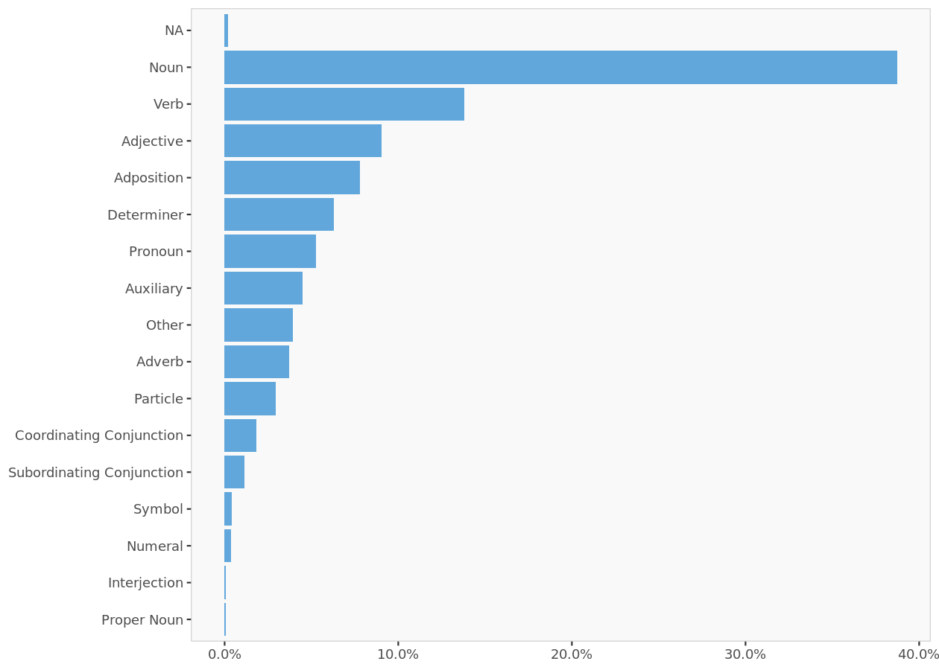
Distribution of Universal Parts of Speech Tags

Slide 28
Tweets- Starbucks order online

Slide 29
Tweets used in the analysis (excerpt)
 | Date | Source | Tweet
1 | 2022-10-13 | Twitter Web App | Always worth remembering that any time you order something online or through an app, a human is on the other side who has to deal with your shit. | Hacked to Bits https://t.co/DfJiHXKpAD
2 | 2022-10-13 | Twitter for Android | @pagesofbellrose So many indies have online shops. I live in the middle of nowhere (like closest Starbucks is an hour away, let alone a bookstore), so I just order online from indies. I do miss browsing in person though.
3 | 2022-10-13 | Twitter for Android | Thank gods the Starbucks app allows me to order online. Iced Chai and a blueberry muffin aquired. Sick Feeling fading.
4 | 2022-10-12 | Twitter for Android | Starbucks in NY has workers on strike. Yet, they allowed customers to order online and then would not refund them after the order was not fulfilled. The company did this in hopes of getting an argument between the workers and customers to take the heat off the themselves. #truth
5 | 2022-10-12 | Twitter for iPhone | @kobemcCoffee Don’t. Stores don’t carry the pods worth a damn (you MAY run into a sleeve of Starbucks) Gotta order them online and the coffees honestly aren’t that good.
6 | 2022-10-12 | Twitter Web App | Work or live in @DwntwnNashville? Your favorite juice, coffee, bites, &amp; sweets are just a short walk or drive away at @amazon I! Order @TheUrbanJuicer or @Starbucks online or in their apps &amp; pick up with 30 minutes of free parking. https://t.co/BQt2USvKF9
7 | 2022-10-11 | Twitter for iPhone | This just reminds me of when I thought the starbucks worker remembered my name and then they said well this is the only online pickup order we have here https://t.co/lD32QEe01z
8 | 2022-10-11 | Twitter for Android | @DavidJo73577137 @That716Guy @TheBuffaloNews Anti union activity always deserves to be called out. Starbucks was literally taking people's online orders and money knowing the shop was closed. Corporate decision. Our County Executive was absolutely correct in alerting people to not order from that particular store.
9 | 2022-10-11 | Twitter for iPhone | They need to ban Starbucks online ordering lol just causes a mob of people to crowd inside waiting for their drink they ordered on their phone 2 seconds before they came in then proceed to make everyone else’s drink take longer 🤦🏻‍♂️ just go through drive through or order normal🤦🏻‍♂️
10 | 2022-10-10 | Twitter for iPhone | i just know that all starbucks baristas hate when people order drinks because of this guy https://t.co/Pfr6auVvCr

Slide 30
Word cloud

Slide 31
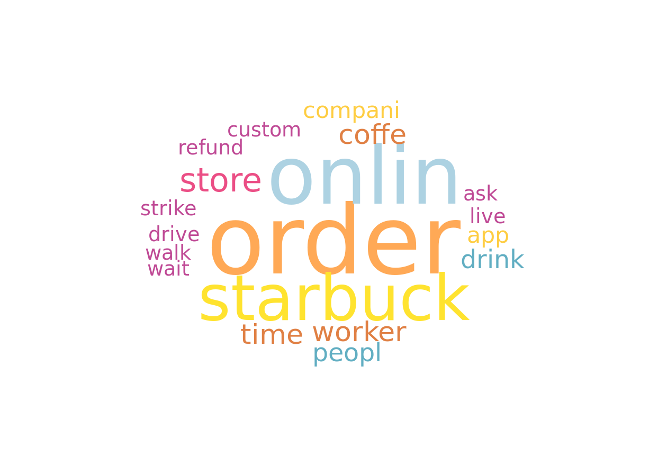
Word cloud
The word cloud represents the most frequently used words inside the corpus of texts provided. The bigger a word appears, the larger the number of times it occurs in the text corpus.

Slide 32
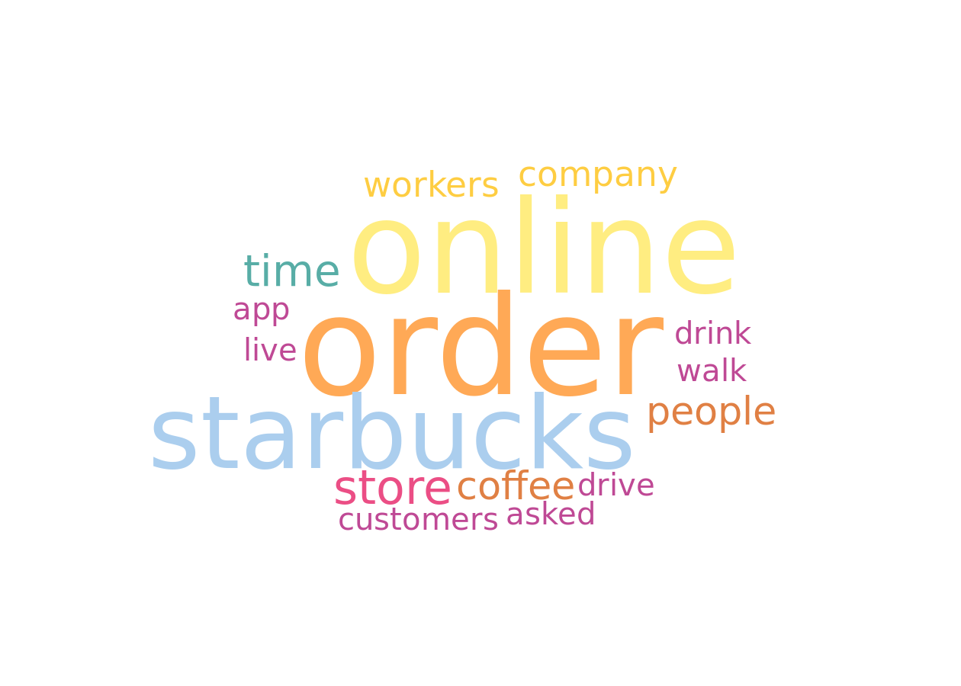
Word cloud without stemming
The word cloud represents the most frequently used words inside the corpus of texts provided. The bigger a word appears, the larger the number of times it occurs in the text corpus.

Slide 33
Valence analysis

Slide 34
Valence repartition
 | Posts count | Relative posts count
Total | 26 | 100%
negative | 14 | 54%
neutral | 3 | 12%
positive | 9 | 35%
The number of posts that fall into different valence categories summarized by their absolute and relative values.

Slide 35
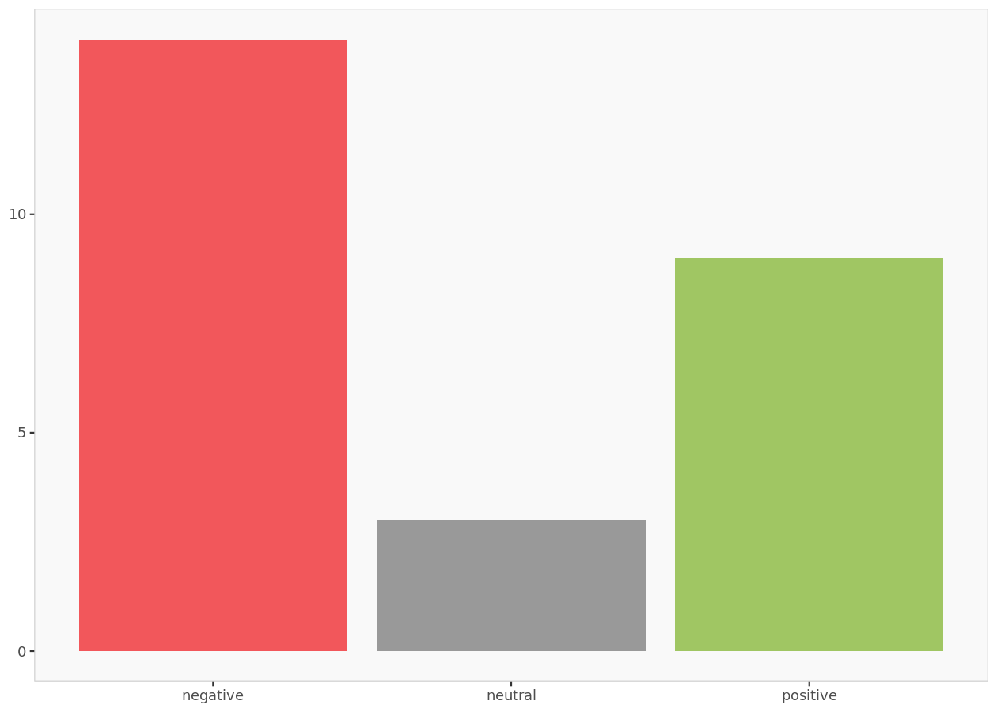
Valence histogram
Keep in mind that it covers only 26 posts
The valence histogram indicates the number of posts by their valence.

Slide 36
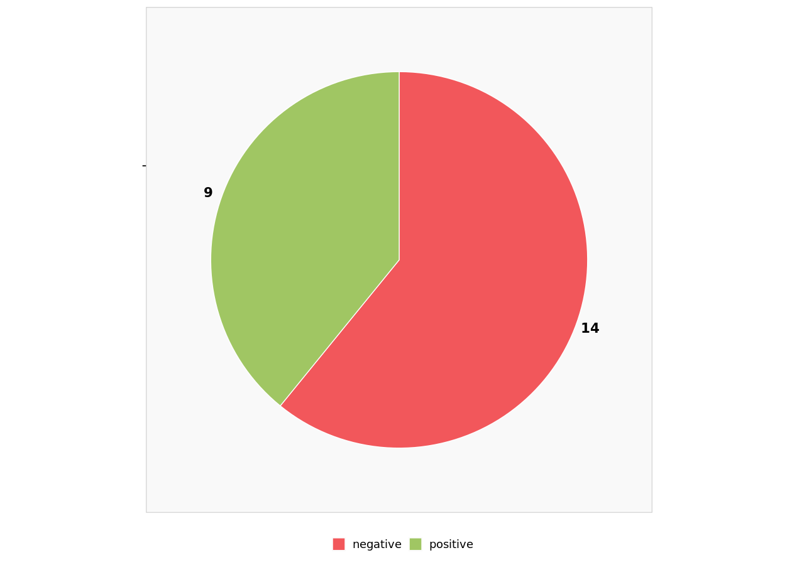
Valence distribution without uncategorized posts
Graphic summary of the relative sizes of the number of posts classified by valence after ignoring posts that could not be categorized (i.e., neutral posts).

Slide 37
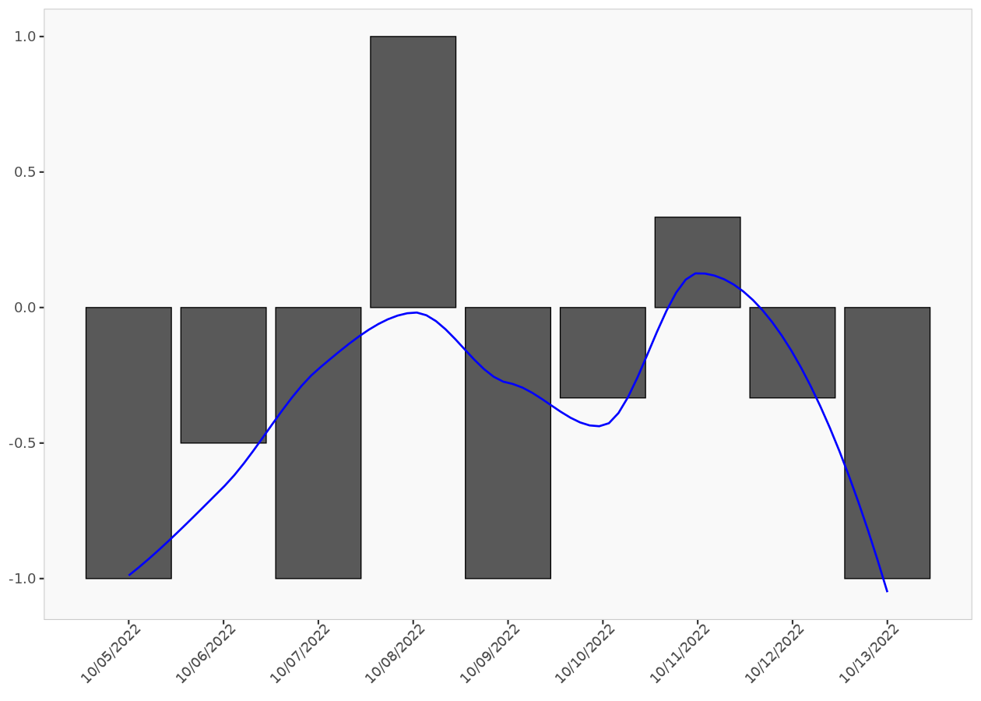
Post valence ratio
The post valence ratio graph indicates the daily average number of positive posts. The blue smoothing line helps visualize the trend.

Slide 38
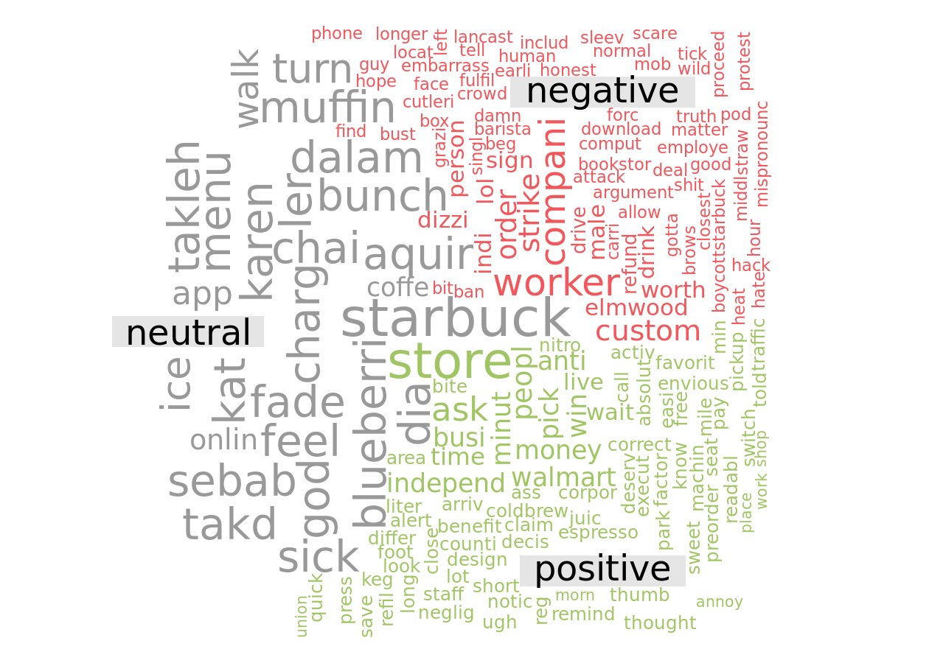
Valence word cloud

Slide 39
Emotion analysis

Slide 40
Emotion repartition
 | Posts count | Relative posts count
Total | 26.00 | 100%
anger | 3.54 | 14%
anticipation | 9.79 | 38%
disgust | 1.54 | 6%
fear | 1.71 | 7%
joy | 1.79 | 7%
sadness | 1.71 | 7%
surprise | 2.63 | 10%
trust | 3.29 | 13%
The number of posts that fall into different emotion categories summarized by their absolute and relative values. If a post has multiple emotions, then it is equally divided among those emotions.

Slide 41
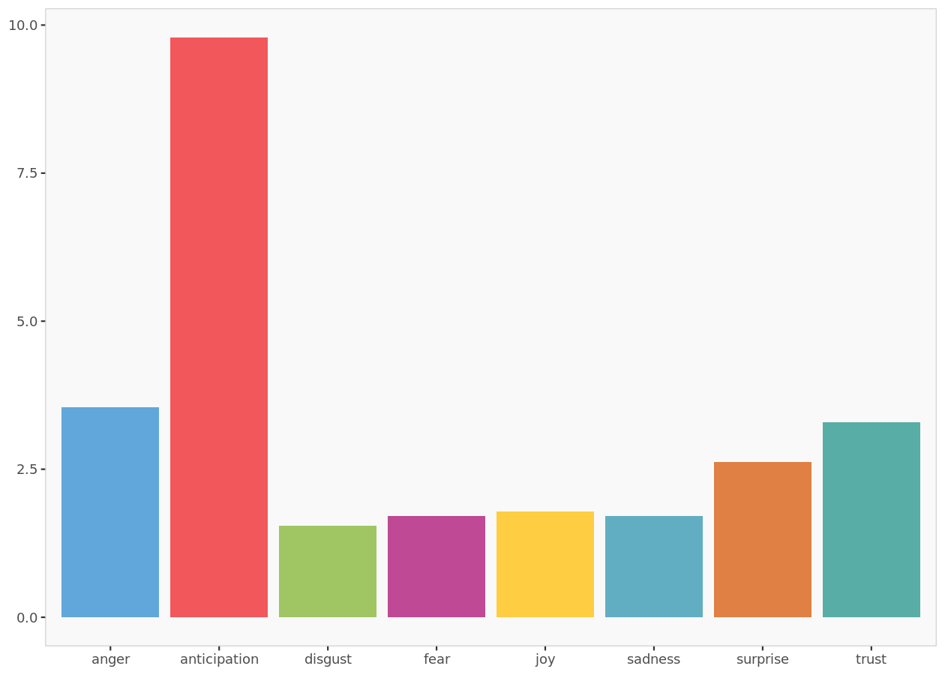
Emotion histogram
The emotion histogram indicates the number of posts by their emotion.

Slide 42
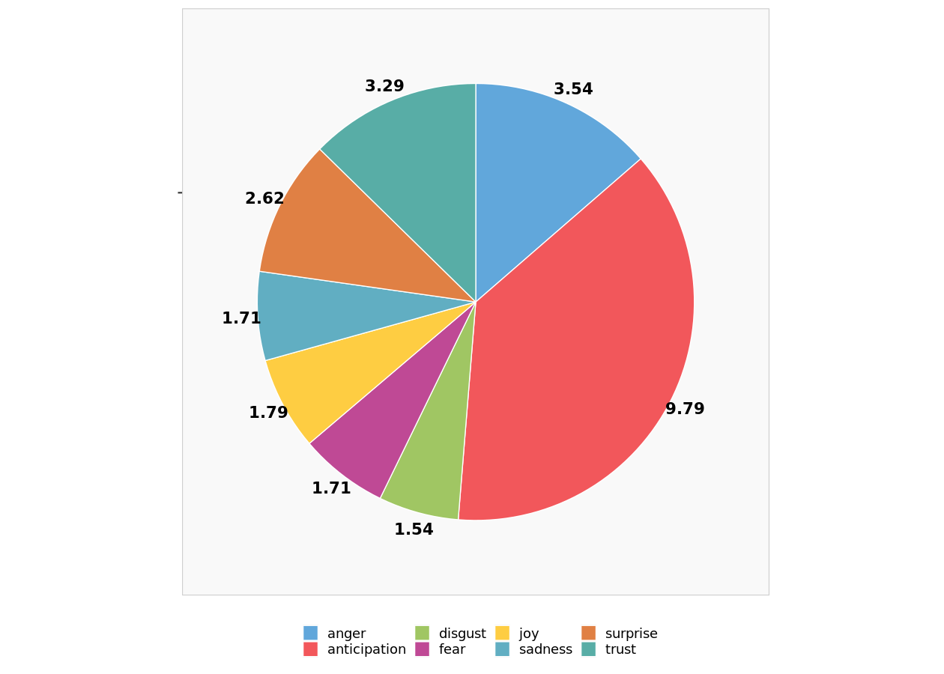
Emotion distribution without uncategorized posts
Graphic summary of the relative sizes of the number of posts classified by emotion after ignoring uncategorized posts.

Slide 43
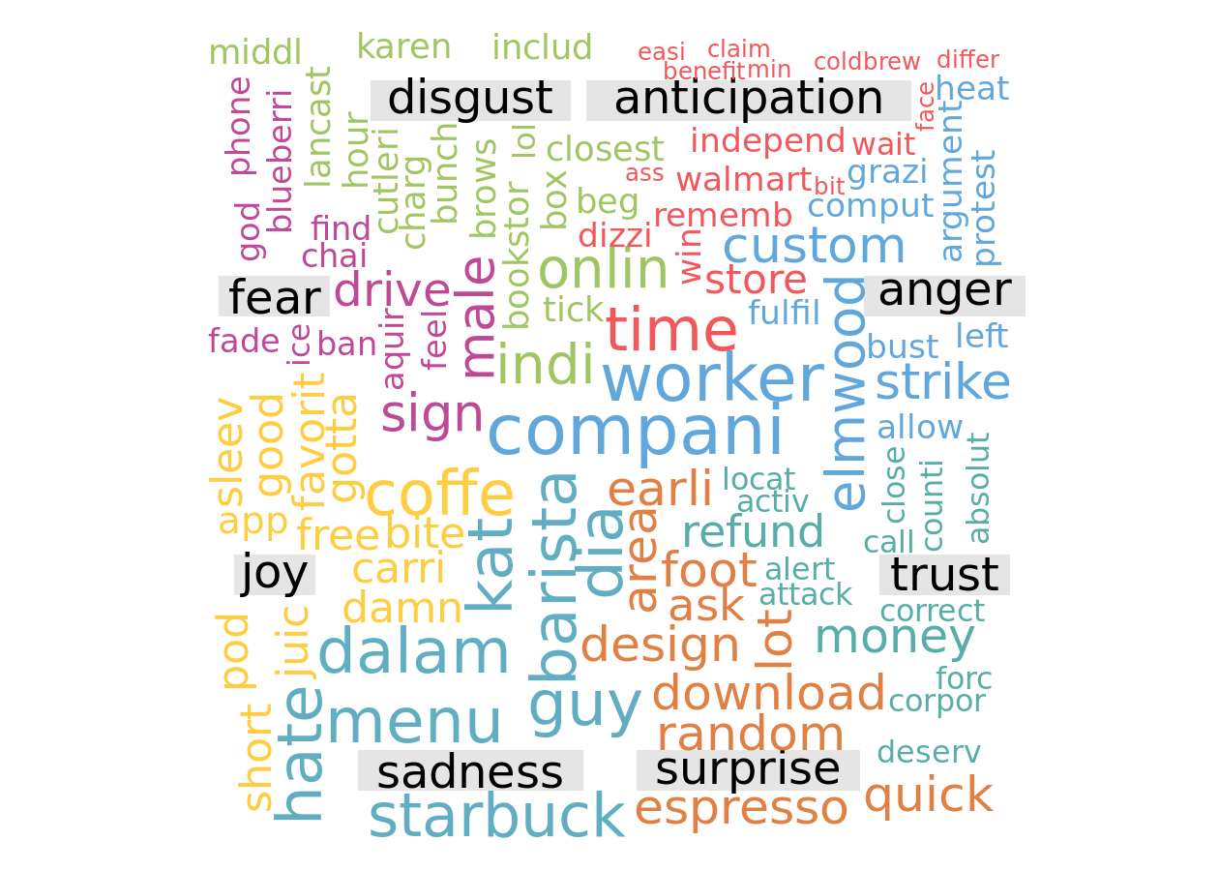
Emotion word cloud
Even if a post has multiple emotions its words will be shown only in one of those emotions.

Slide 44
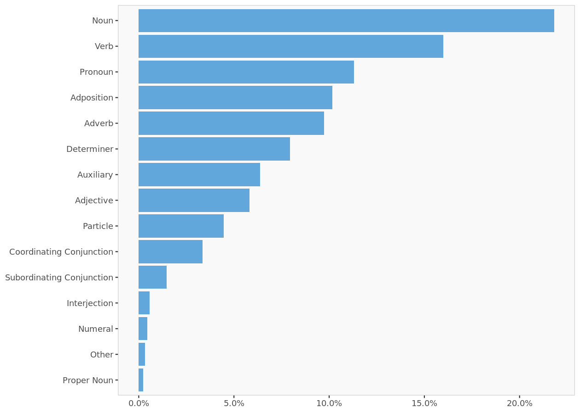
Distribution of Universal Parts of Speech Tags

Slide 45
Tweets – Starbucks Mobile order

Slide 46
Tweets used in the analysis (excerpt)
 | Date | Source | Tweet
1 | 2022-10-13 | Twitter for iPhone | There’s 3 Starbucks around me and every time I do a mobile order they mess it up big time🙂 I’m about to stop going
2 | 2022-10-13 | Twitter for iPhone | Does anyone else place a mobile order from the Starbucks parking lot and then wait in the car till it’s ready? No? Just me?
3 | 2022-10-13 | Twitter for iPhone | clicked on a previous order for starbucks to send in as a mobile order only to realize when i picked it up that it was an in person order i made where the barista got my syrup wrong ):
4 | 2022-10-13 | Twitter for iPhone | It was literally 20+ people @Starbucks waiting for they order……I did a mobile order and it wasn’t ready ……I had to leave without my drink 😒😒😒😒
5 | 2022-10-13 | Twitter for iPhone | The Starbucks I go to isn’t accepting mobile orders. Now I have to go in and deal with awkward human interaction as I awkwardly order my modified drink lmfao. My social anxiety is already making me panic a little ahaha
6 | 2022-10-13 | Twitter for iPhone | Somebody took my Starbucks order because it was 2 Taylor’s in the mobile pickup area 🙁 now I gotta wait 😩
7 | 2022-10-13 | Twitter for iPhone | Not me pulling up to Starbucks this morning and me telling the girl I’m picking up a mobile order for Rebecca and her going “you want me to put the sriracha in the bag?” Lmfao I’m that person now. Thanks Erin ♥️😂 I’ll see you tomorrow morning
8 | 2022-10-13 | Twitter for iPhone | sitting in the starbucks line 10+ minutes for my mobile order because i’m too afraid to parallel park in the city
9 | 2022-10-13 | Twitter for iPhone | @KatieHerringt13 I actually have to call Starbucks tonight to switch my account back to US. I’ll trade not being able to mobile order in exchange for delta skymiles.
10 | 2022-10-13 | Twitter for iPhone | I already gotta wait 10 minutes for a mobile order because they gotta do all of these customized cold drinks. I’d air a Starbucks out if I had to wait on a fool to get a pack of squares too. https://t.co/8SA2t3bsD8

Slide 47
Word cloud

Slide 48
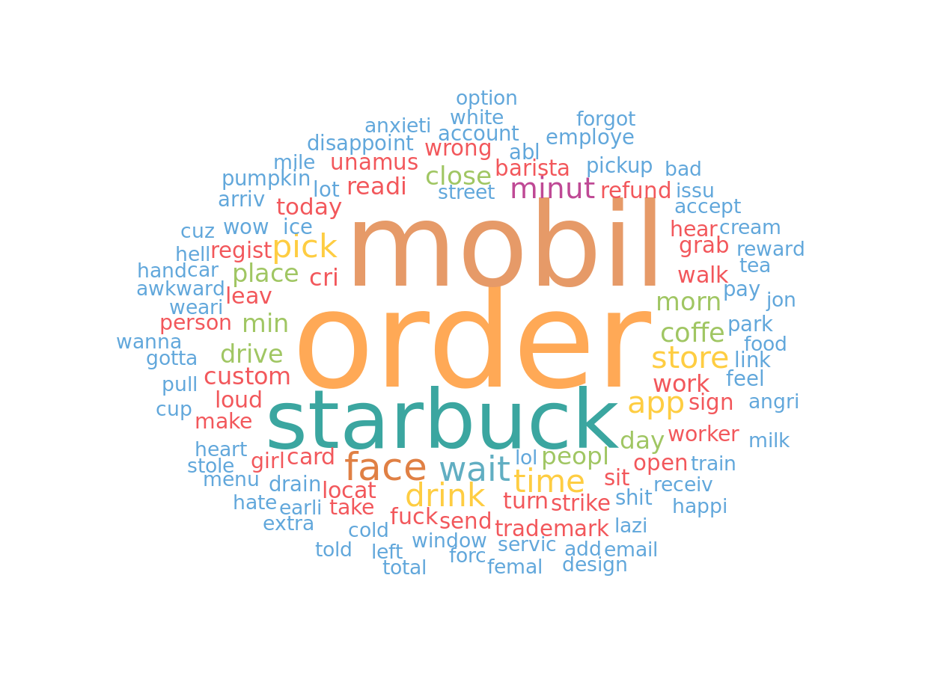
Word cloud
The word cloud represents the most frequently used words inside the corpus of texts provided. The bigger a word appears, the larger the number of times it occurs in the text corpus.

Slide 49
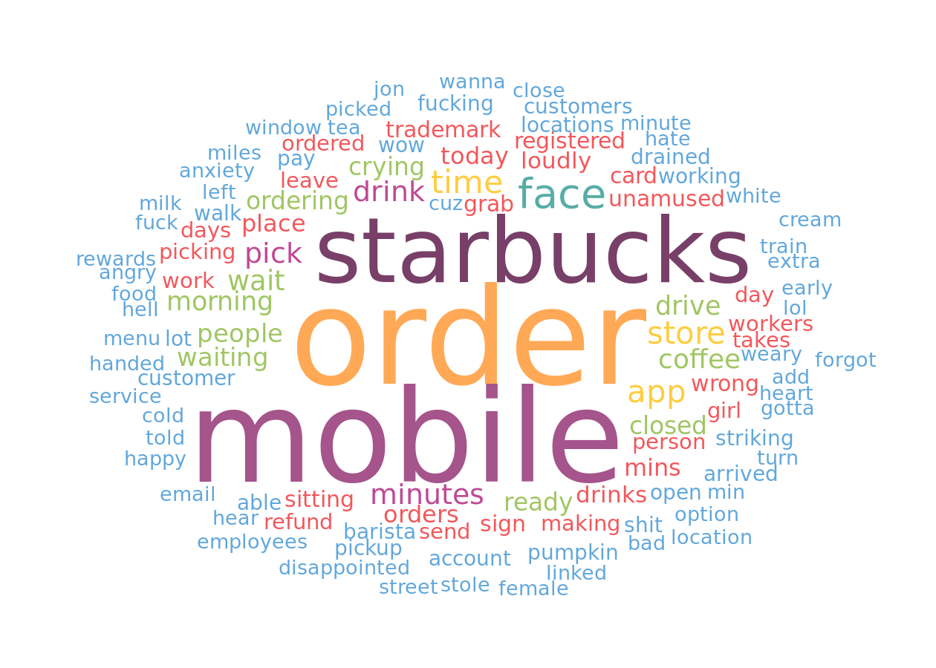
Word cloud without stemming
The word cloud represents the most frequently used words inside the corpus of texts provided. The bigger a word appears, the larger the number of times it occurs in the text corpus.

Slide 50
Valence analysis

Slide 51
Valence repartition
 | Posts count | Relative posts count
Total | 157 | 100%
negative | 70 | 45%
neutral | 16 | 10%
positive | 71 | 45%
The number of posts that fall into different valence categories summarized by their absolute and relative values.

Slide 52
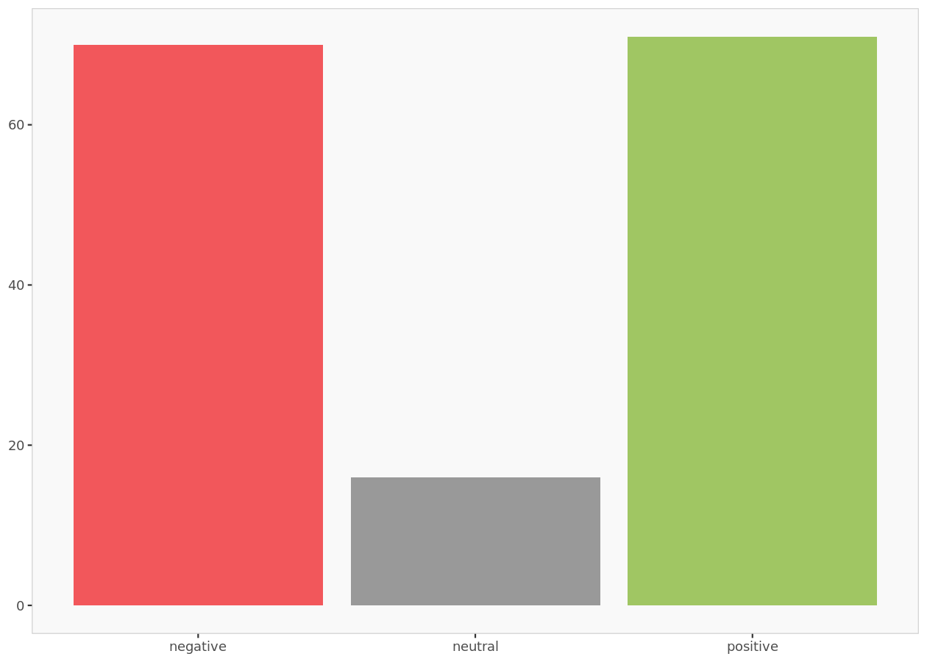
Valence histogram
The valence histogram indicates the number of posts by their valence.

Slide 53
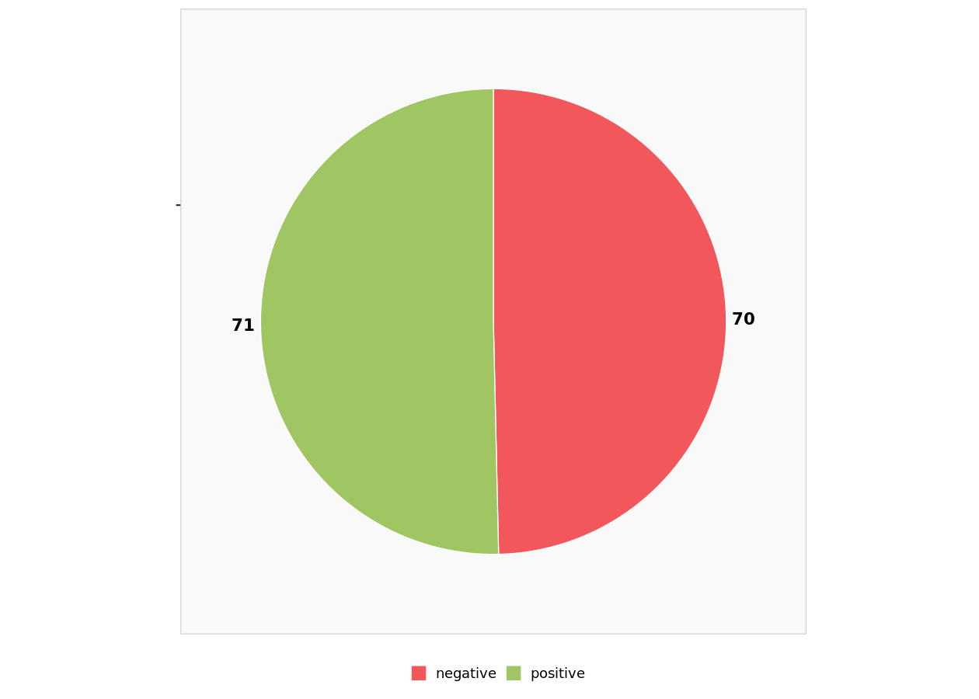
Valence distribution without uncategorized posts
Graphic summary of the relative sizes of the number of posts classified by valence after ignoring posts that could not be categorized (i.e., neutral posts).

Slide 54
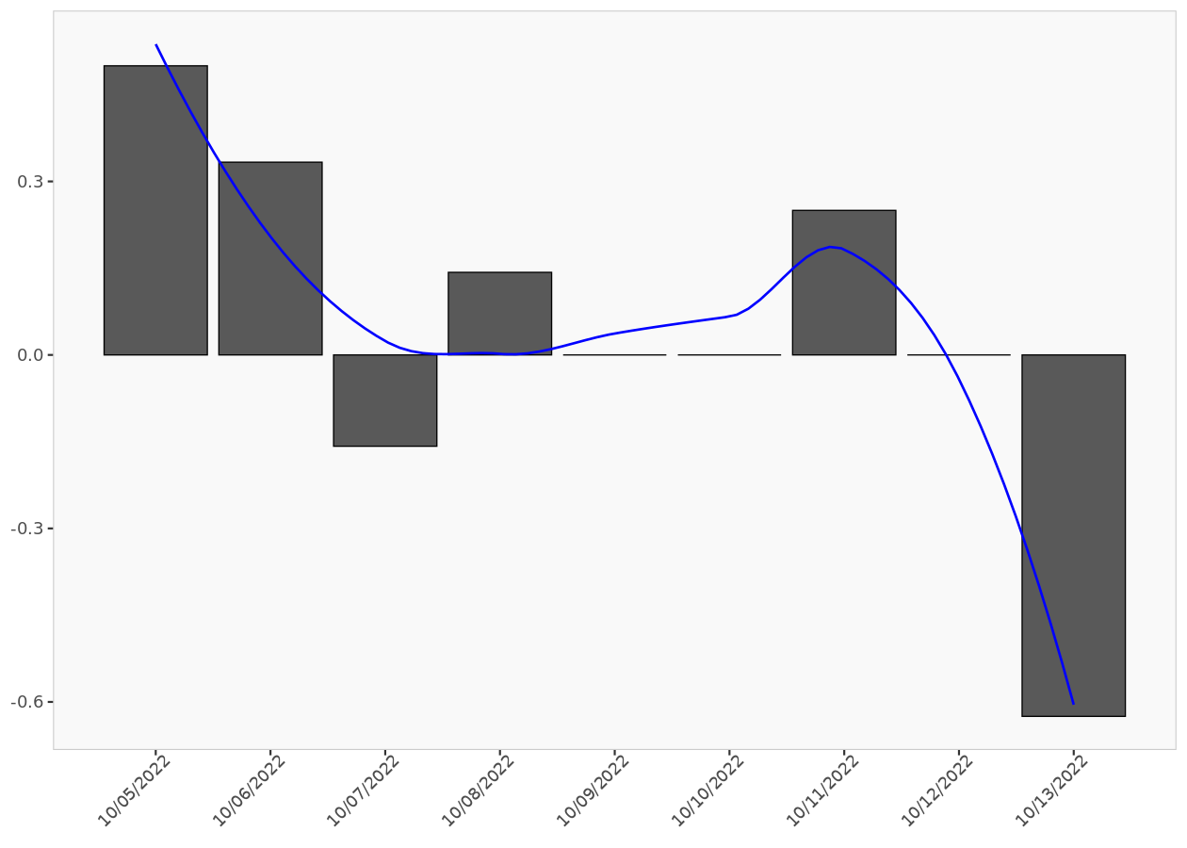
Post valence ratio
The post valence ratio graph indicates the daily average number of positive posts. The blue smoothing line helps visualize the trend.

Slide 55
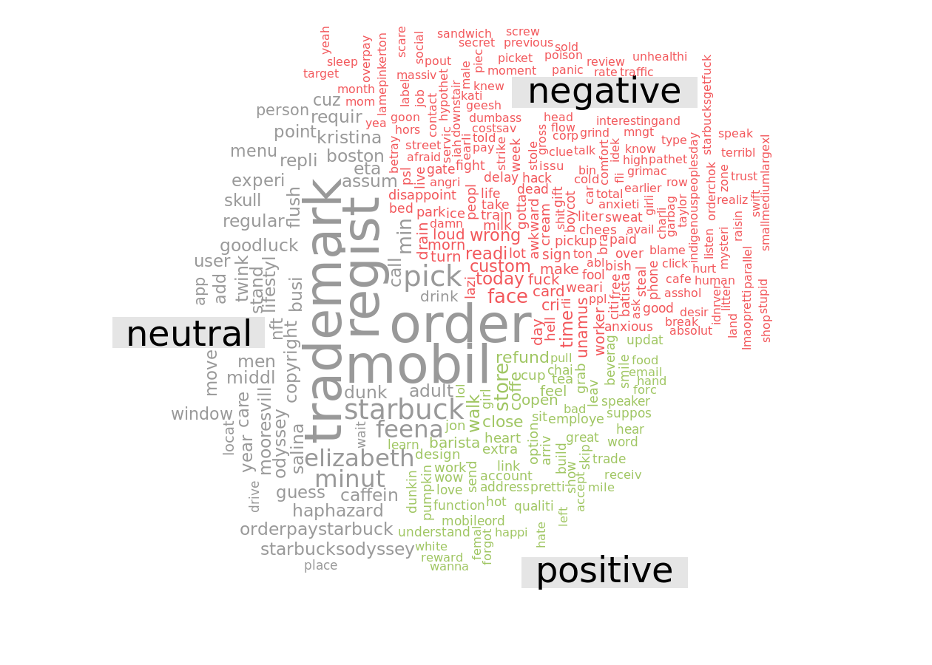
Valence word cloud

Slide 56
Emotion analysis

Slide 57
Emotion repartition
 | Posts count | Relative posts count
Total | 157.00 | 100%
anger | 8.72 | 6%
anticipation | 115.72 | 74%
disgust | 4.30 | 3%
fear | 5.13 | 3%
joy | 3.58 | 2%
sadness | 8.97 | 6%
surprise | 1.50 | 1%
trust | 9.08 | 6%
The number of posts that fall into different emotion categories summarized by their absolute and relative values. If a post has multiple emotions, then it is equally divided among those emotions.

Slide 58
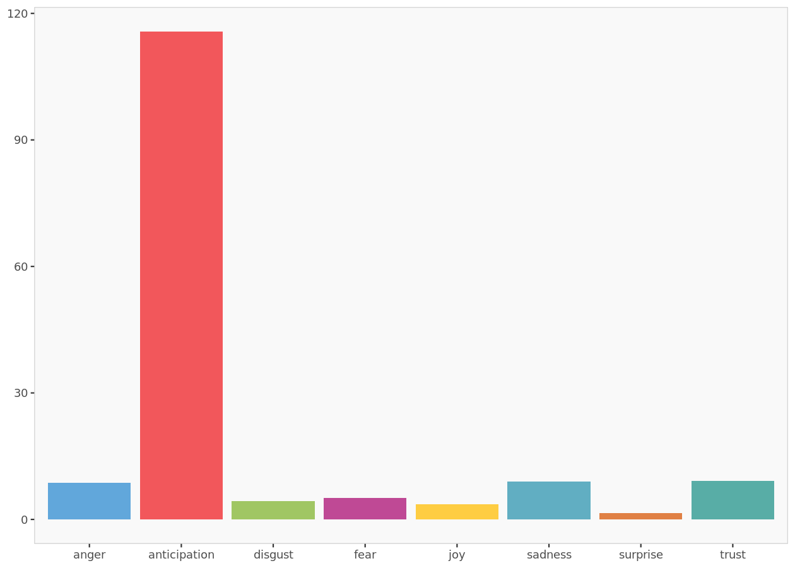
Emotion histogram
The emotion histogram indicates the number of posts by their emotion.

Slide 59
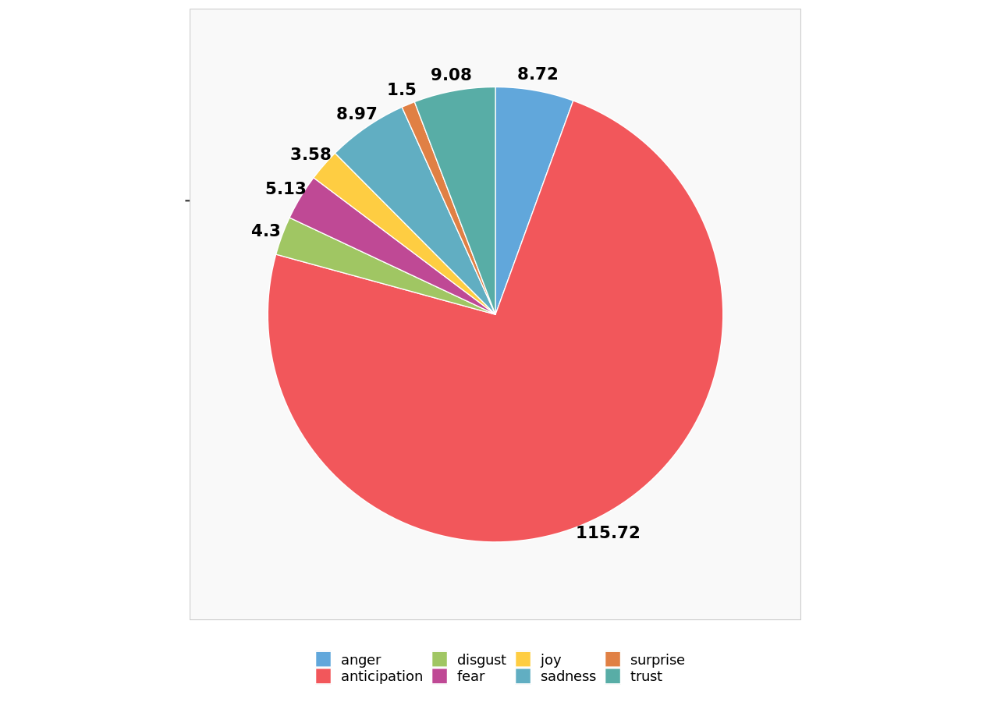
Emotion distribution without uncategorized posts
Graphic summary of the relative sizes of the number of posts classified by emotion after ignoring uncategorized posts.

Slide 60
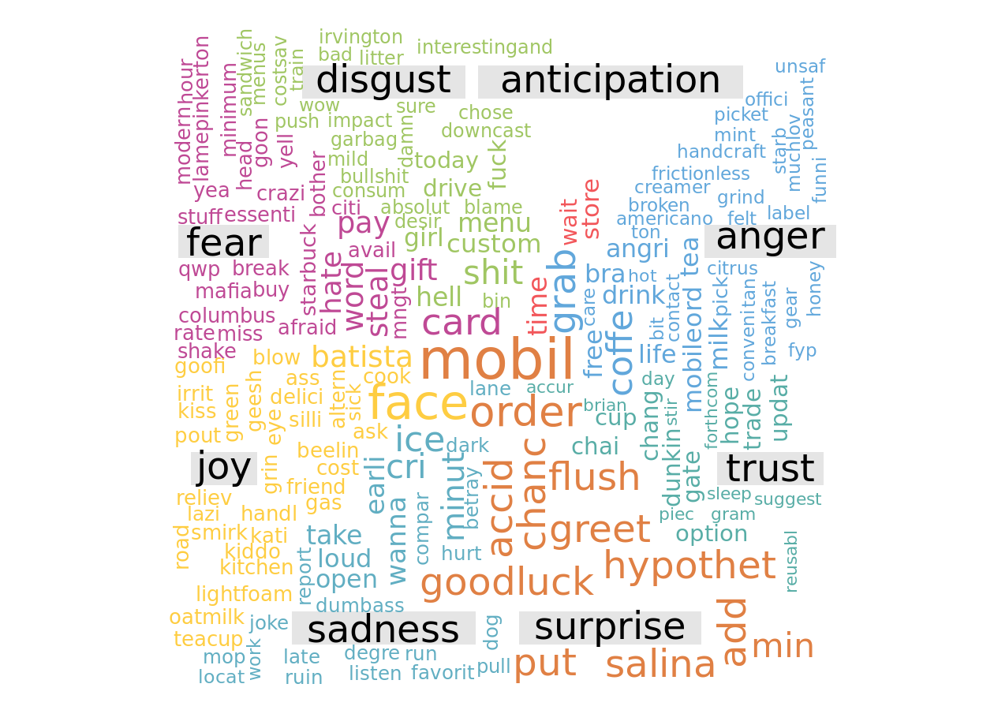
Emotion word cloud
Even if a post has multiple emotions its words will be shown only in one of those emotions.

Slide 61
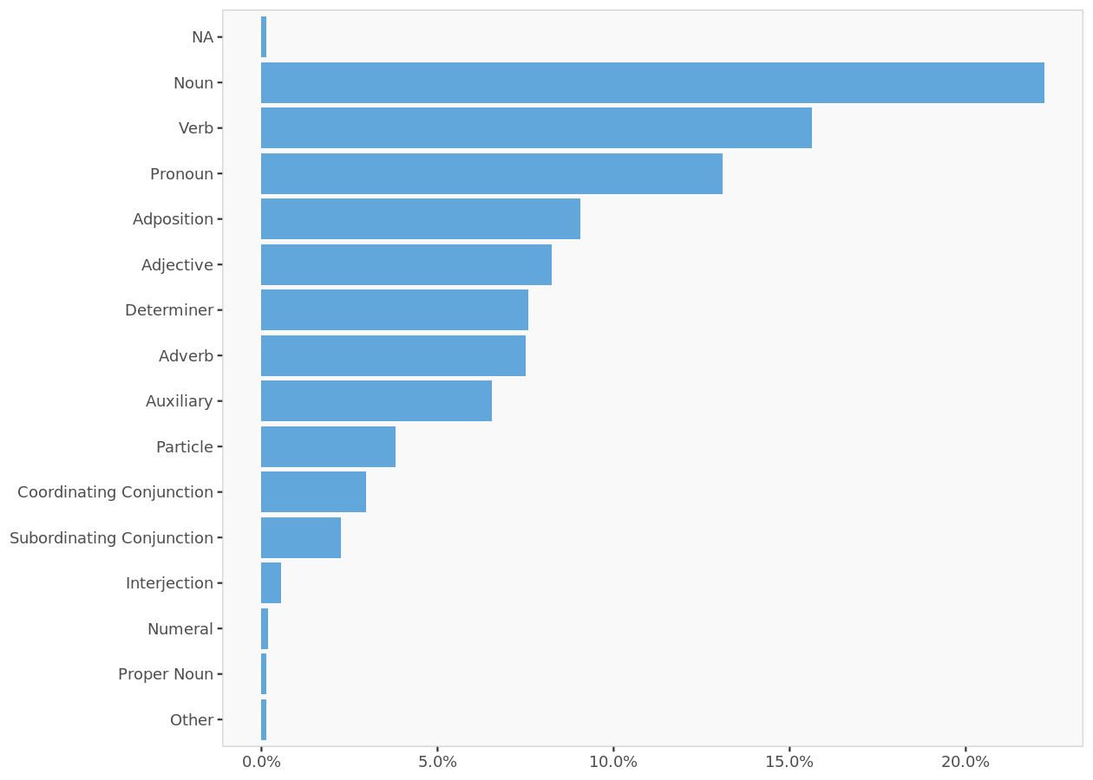
Distribution of Universal Parts of Speech Tags

Slide 62
Tweets- Starbucks Card Payment

Slide 63
Tweets used in the analysis (excerpt)
 | Date | Source | Tweet
1 | 2022-10-14 | Twitter for iPhone | @Starbucks @StarbucksIndia I paid for a gift card. Payment got deducted but received a message stating “Gift not composed successfully” Please help. @StarbucksNews @StarbucksCare https://t.co/a4t75iXR1Y
2 | 2022-10-13 | Twitter for Android | $BKKT ☕ Starbucks: introduces a new payment choice for Starbucks customers, who can convert supported loyalty and rewards points, bitcoin, frequent flyer miles, and gift cards in the Bakkt App into USD to then reload their Starbucks Card saved in the Starbucks app.
3 | 2022-10-13 | Twitter for Android | udah 2x ke Starbucks cijantung mall, payment pakai Starbucks card tapi kok gaada di history &amp; stars ga nambah ya? _ @SbuxIndonesia
4 | 2022-10-11 | Twitter for Android | @WebIsBae @Starbucks https://t.co/Wa8PPxQQpr
5 | 2022-10-11 | Twitter for iPhone | @messiecondo @samtabahriti If it was payment from the gruesome twosome then it was probably a $5 Starbucks card …
6 | 2022-10-10 | Twitter for Android | Terms and conditions:_Member's Day – Earn 20 BONUS STARS for every handcrafted beverage purchased_Promotion date: 11th October 2022 (whole day)_Beverage selection: applicable for ALL handcrafted beverages_1) Full payment must be made with registered Starbucks Card or Mobile App.
7 | 2022-10-06 | Twitter Web App | 🎉Purchase 2 Grande-sized Frappuccino at only RM 26 with Starbucks Card/Mobile App._🎉Purchase 2 Grande-sized Frappuccino at only RM 28 with other payment methods.__Promotion Date: 7th October 2022_Time: 5pm – 8pm__*T&amp;Cs in the next tweets.
8 | 2022-10-06 | Twitter Web App | Terms and Conditions_Purchase 2 Grande-sized Frappuccino at RM26 (payment with Starbucks Card/Mobile App). **RM28 with other payment methods._• Price is inclusive of 6% Service Tax._• Upsize is chargeable at RM3.00.
9 | 2022-10-08 | Twitter for iPhone | These food delivery apps should start accepting my Starbucks card as a payment method
10 | 2022-10-08 | Twitter for iPhone | Visit us at City Centre Bahrain ground floor, next to Starbucks, from 6 to 9 October. Timings: 10am to 10pm.__Apply for a new BBK credit card and earn 10,000 loyalty points. You can also convert your purchases to monthly equal payment installments, with zero interest. https://t.co/36qSp4V1E3

Slide 64
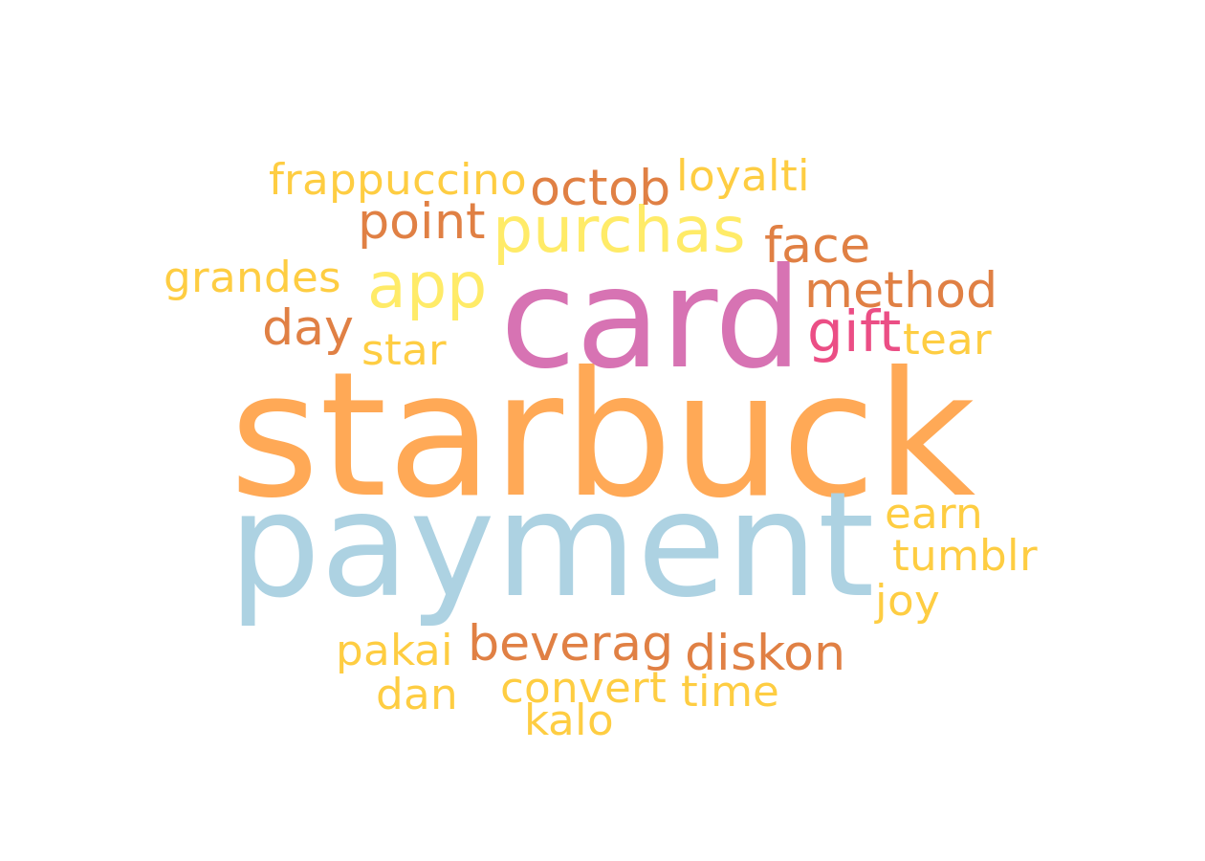
Word cloud
The word cloud represents the most frequently used words inside the corpus of texts provided. The bigger a word appears, the larger the number of times it occurs in the text corpus.

Slide 65
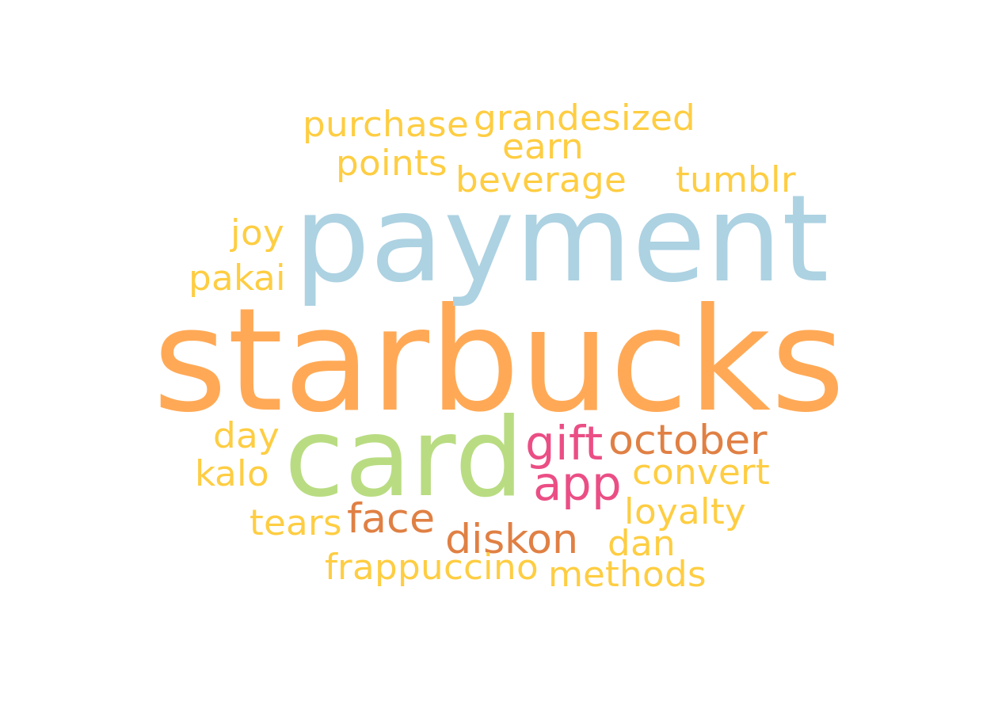
Word cloud without stemming
The word cloud represents the most frequently used words inside the corpus of texts provided. The bigger a word appears, the larger the number of times it occurs in the text corpus.

Slide 66
Valence analysis

Slide 67
Valence repartition
 | Posts count | Relative posts count
Total | 17 | 100%
negative | 8 | 47%
neutral | 1 | 6%
positive | 8 | 47%
The number of posts that fall into different valence categories summarized by their absolute and relative values.

Slide 68
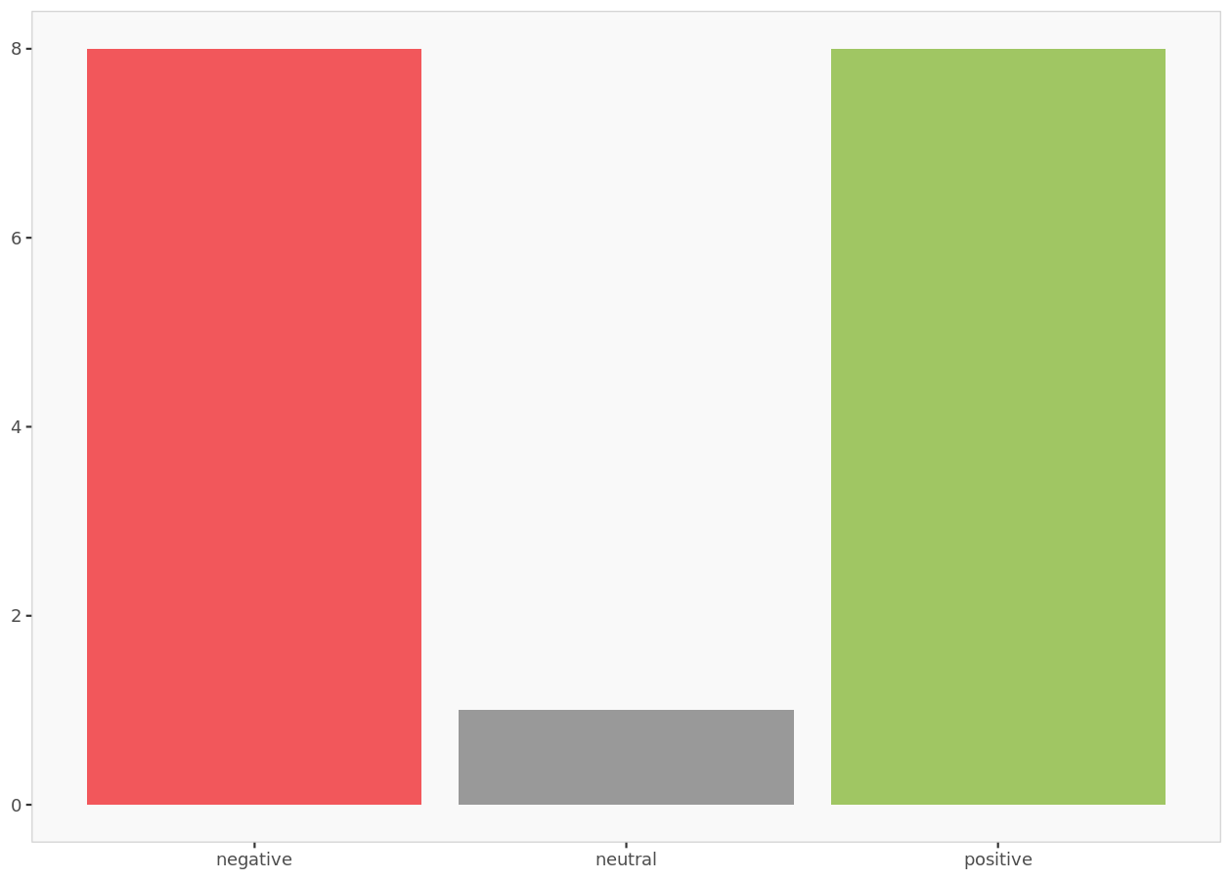
Valence histogram
The valence histogram indicates the number of posts by their valence.

Slide 69

Valence distribution without uncategorized posts
Graphic summary of the relative sizes of the number of posts classified by valence after ignoring posts that could not be categorized (i.e., neutral posts).

Slide 70
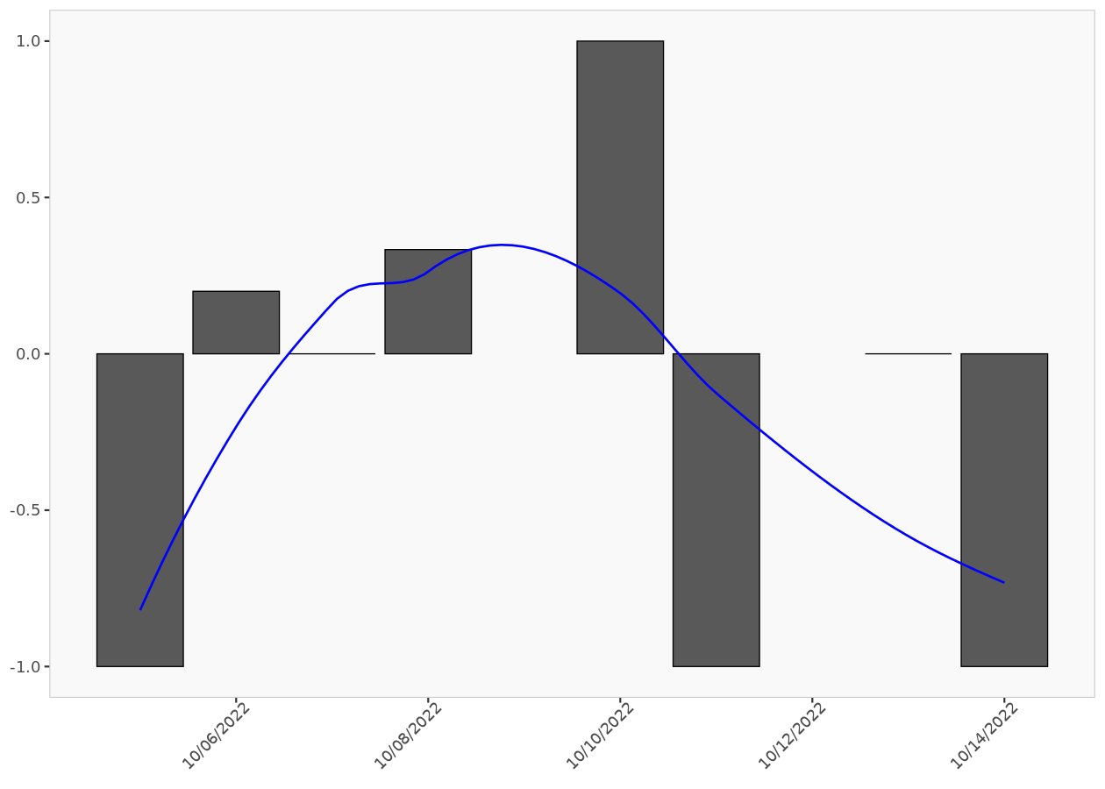
Post valence ratio
The post valence ratio graph indicates the daily average number of positive posts. The blue smoothing line helps visualize the trend.

Slide 71
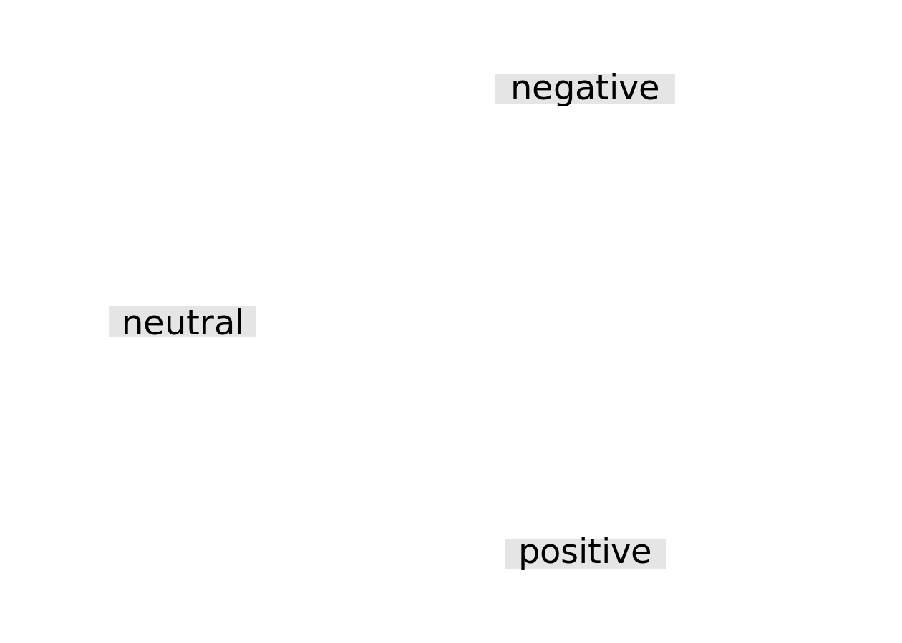
Valence word cloud

Slide 72
Emotion analysis

Slide 73
Emotion repartition
 | Posts count | Relative posts count
Total | 17.00 | 100%
anger | 0.83 | 5%
anticipation | 4.16 | 24%
disgust | 1.63 | 10%
fear | 0.63 | 4%
joy | 3.16 | 19%
sadness | 2.13 | 13%
surprise | 1.16 | 7%
trust | 3.33 | 20%
The number of posts that fall into different emotion categories summarized by their absolute and relative values. If a post has multiple emotions, then it is equally divided among those emotions.

Slide 74
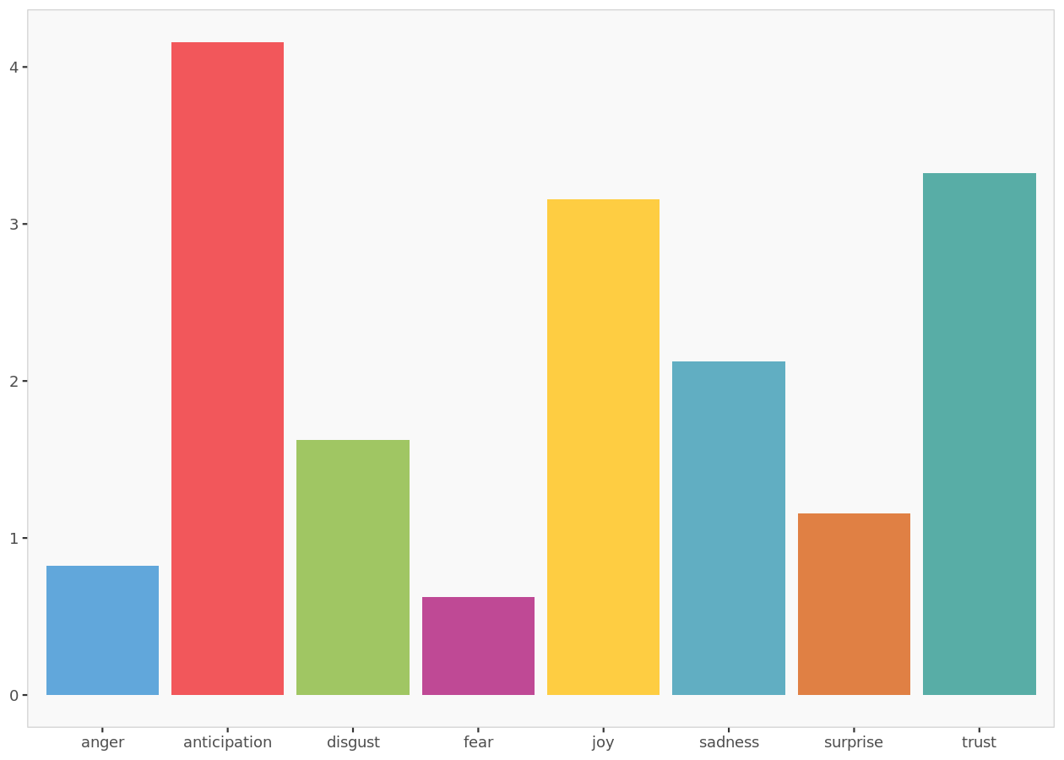
Emotion histogram
The emotion histogram indicates the number of posts by their emotion.

Slide 75
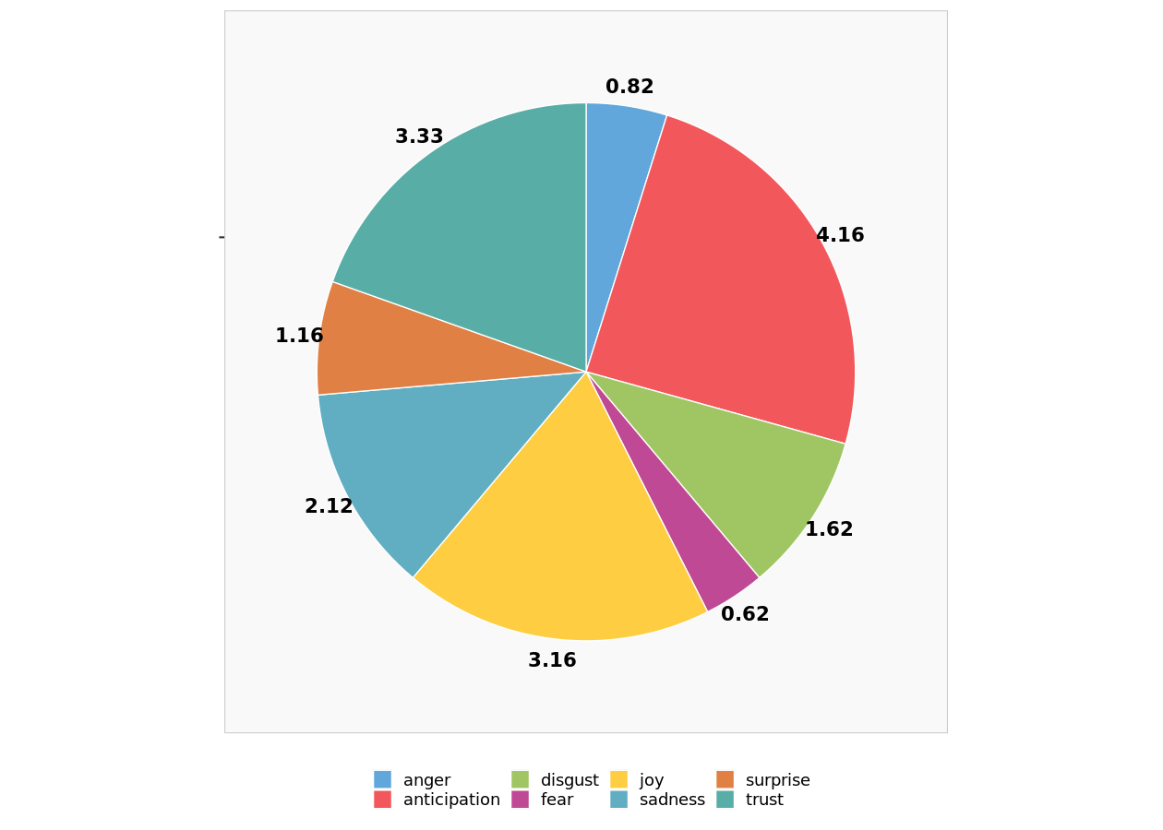
Emotion distribution without uncategorized posts
Graphic summary of the relative sizes of the number of posts classified by emotion after ignoring uncategorized posts.

Slide 76
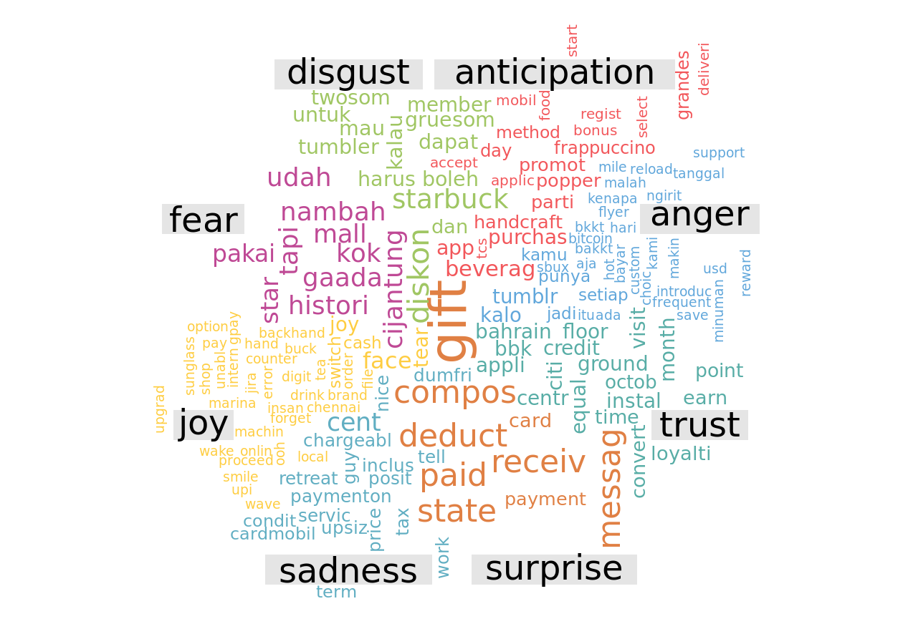
Emotion word cloud
Even if a post has multiple emotions its words will be shown only in one of those emotions.

Slide 77
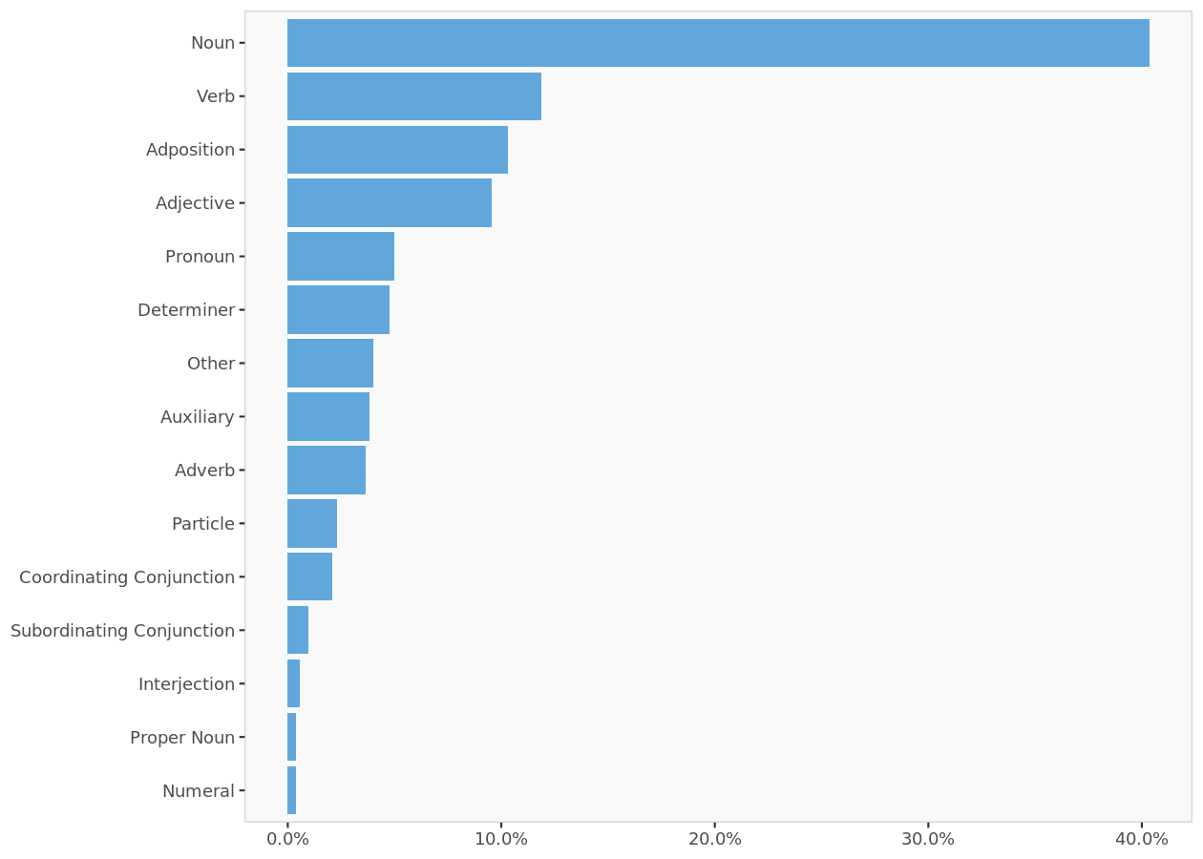
Distribution of Universal Parts of Speech Tags

Slide 78
Tweets – Starbucks Rewards

Slide 79
Tweets used in the analysis (excerpt)
 | Date | Source | Tweet
1 | 2022-10-14 | Twitter for iPhone | https://t.co/futJNUX1qu
2 | 2022-10-14 | Twitter for iPhone | なんだ、とうとうノートくれないならやらなくていいや。_この2年ノートのノルマ激むずなってたしね…__https://t.co/FiT5F83Xn6
3 | 2022-10-14 | True Anthem | Starbucks' rewards members account for half of the company's transactions. Its partnership with Delta will make its benefits even more valuable to members, an executive says. @starbucks https://t.co/e7Dmn1TOly
4 | 2022-10-13 | True Anthem | Starbucks' rewards members account for half of the company's transactions. Its partnership with Delta will make its benefits even more valuable to members, an executive says. @starbucks https://t.co/T1yJAv2hRw
5 | 2022-10-14 | True Anthem | Starbucks' rewards members account for half of the company's transactions. Its partnership with Delta will make its benefits even more valuable to members, an executive says. @starbucks https://t.co/12b4MRhOiS
6 | 2022-10-13 | True Anthem | Starbucks' rewards members account for half of the company's transactions. Its partnership with Delta will make its benefits even more valuable to members, an executive says. @starbucks https://t.co/xtaUmJhsGO
7 | 2022-10-14 | Twitter for iPhone | ✅スターバックス リワード5周年記念__リワードがざくざく貯まるキャンペーンきてますね❤️__エントリーが必要ですので、スタバよく使う人はぜひ✨__https://t.co/f4LykPWUVf https://t.co/yNuv7ERzFK
8 | 2022-10-14 | dlvr.it | Starbucks, Delta link rewards programs https://t.co/gDepjM4t6v via @marketingdive https://t.co/zBoZ0KRET2
9 | 2022-10-14 | Twitter for iPhone | Delta, Starbucks team up with loyalty program partnership for free coffee, miles https://t.co/oI2QlHhxPZ
10 | 2022-10-12 | Twitter Web App | Once-loyal customers have been decrying the policy change on the Dunkin’ subreddit, pledging to uninstall the app and defect to Starbucks. https://t.co/PtxpjUe8xT via @[object
For full listing of tweets, use Excel version of output.

Slide 80
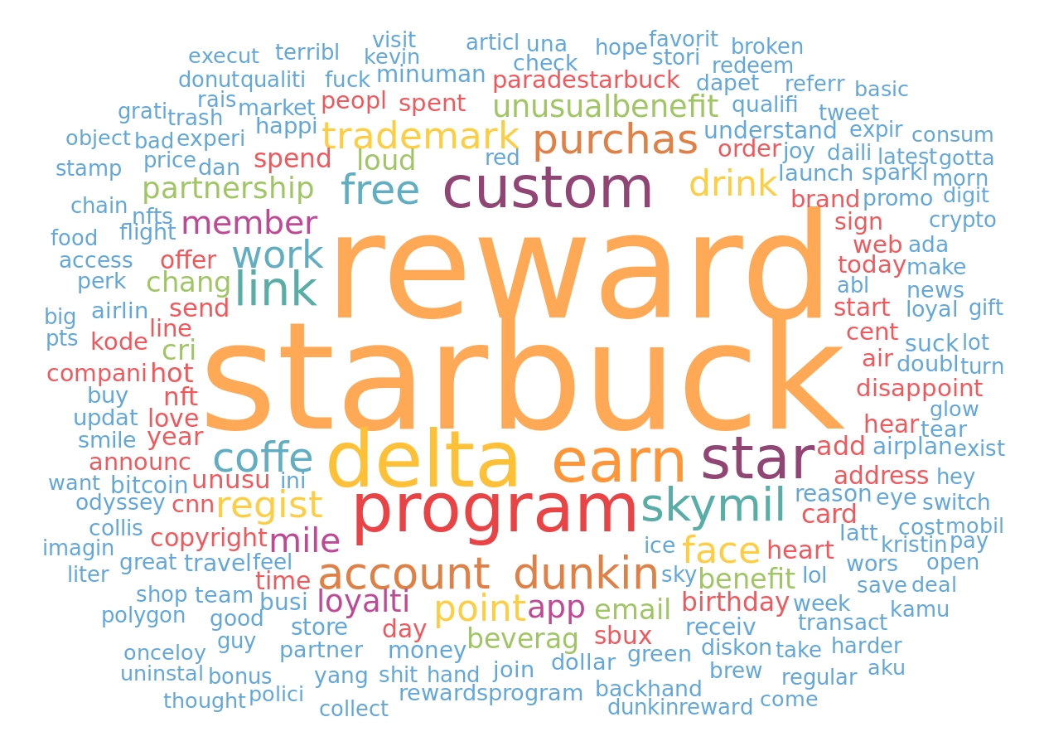
Word cloud
The word cloud represents the most frequently used words inside the corpus of texts provided. The bigger a word appears, the larger the number of times it occurs in the text corpus.

Slide 81
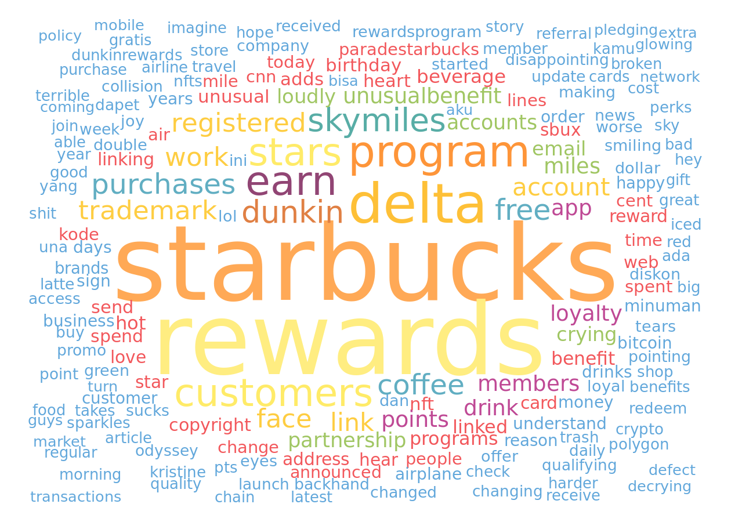
Word cloud without stemming
The word cloud represents the most frequently used words inside the corpus of texts provided. The bigger a word appears, the larger the number of times it occurs in the text corpus.

Slide 82
Valence analysis

Slide 83
Valence repartition
 | Posts count | Relative posts count
Total | 903 | 100%
negative | 104 | 12%
neutral | 92 | 10%
positive | 707 | 78%
The number of posts that fall into different valence categories summarized by their absolute and relative values.

Slide 84
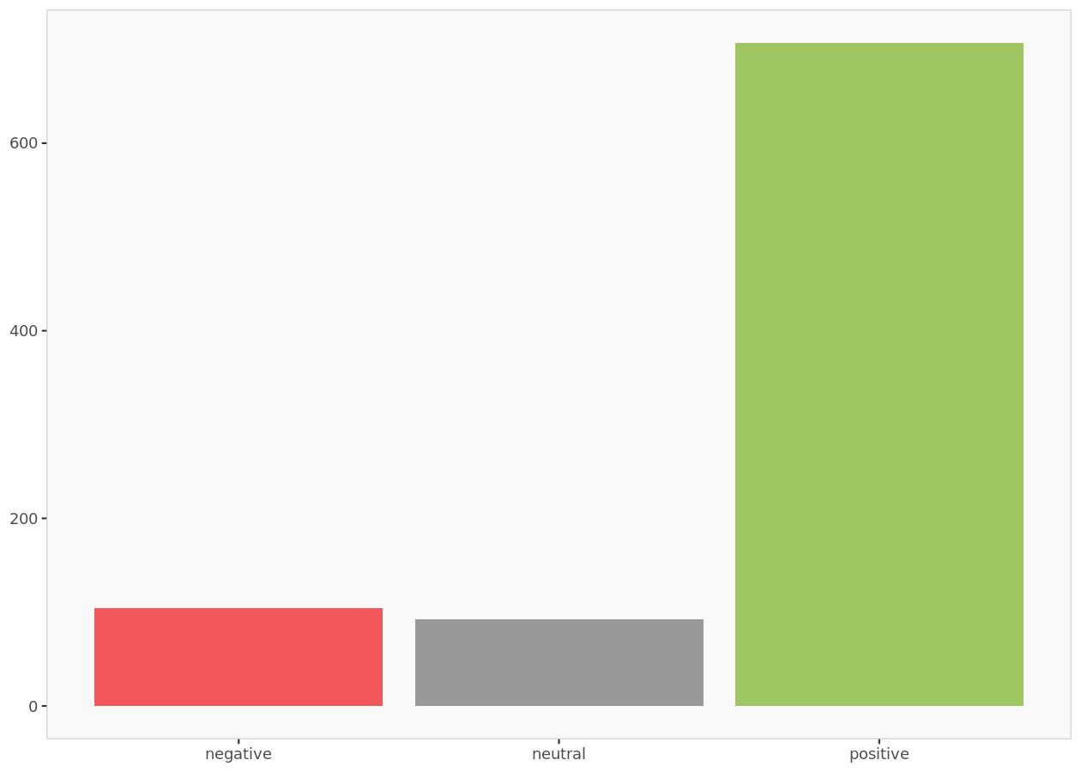
Valence histogram
The valence histogram indicates the number of posts by their valence.

Slide 85
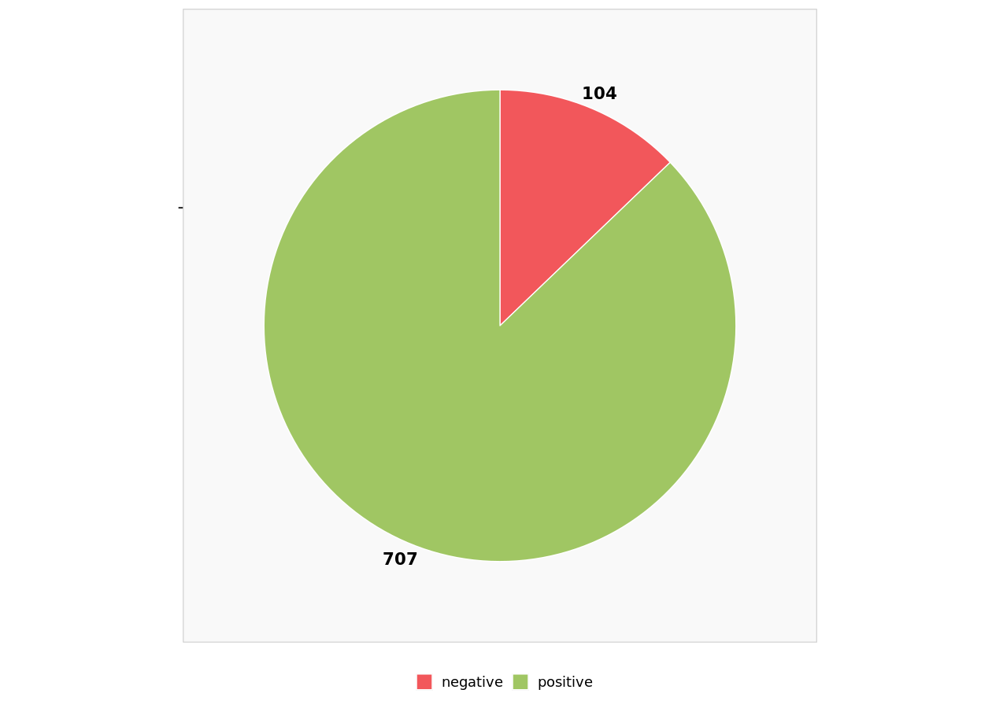
Valence distribution without uncategorized posts
Graphic summary of the relative sizes of the number of posts classified by valence after ignoring posts that could not be categorized (i.e., neutral posts).

Slide 86
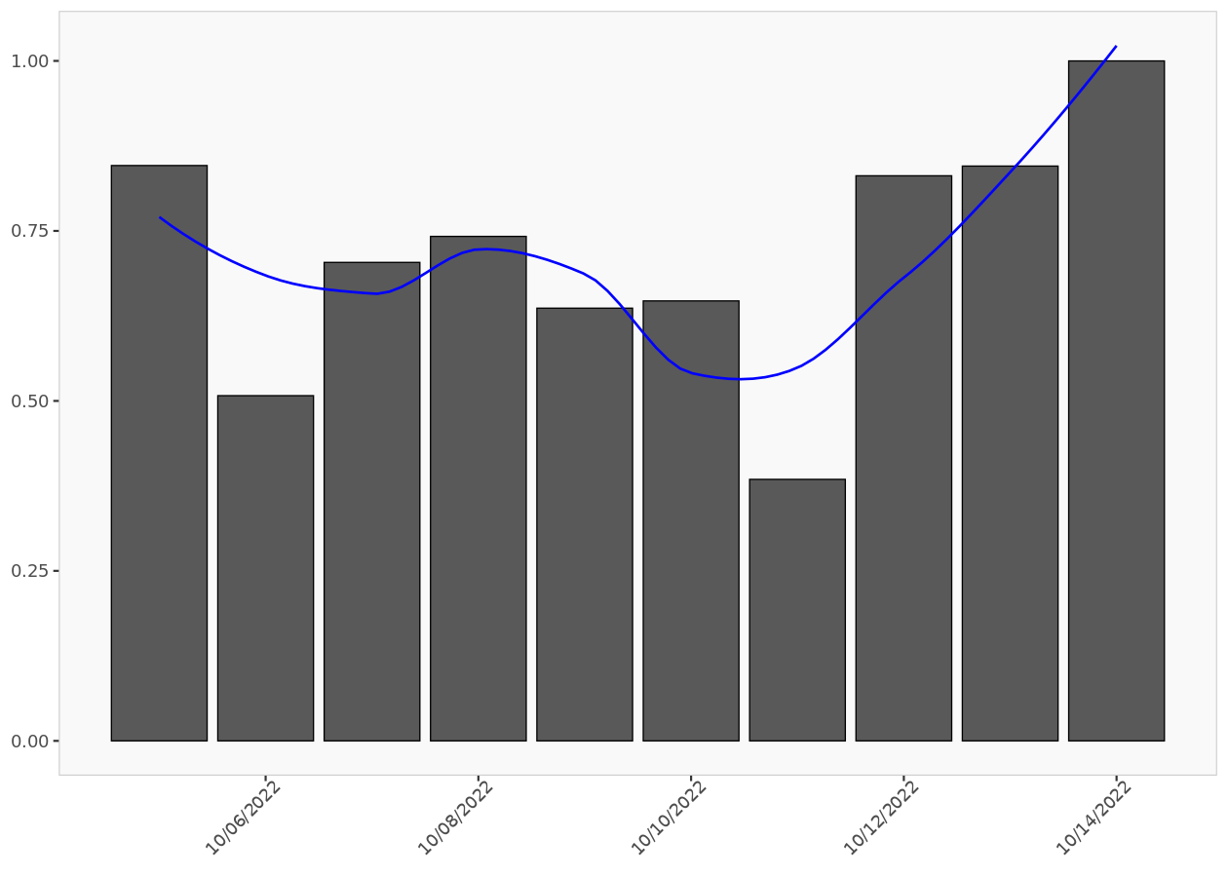
Post valence ratio
The post valence ratio graph indicates the daily average number of positive posts. The blue smoothing line helps visualize the trend.

Slide 87
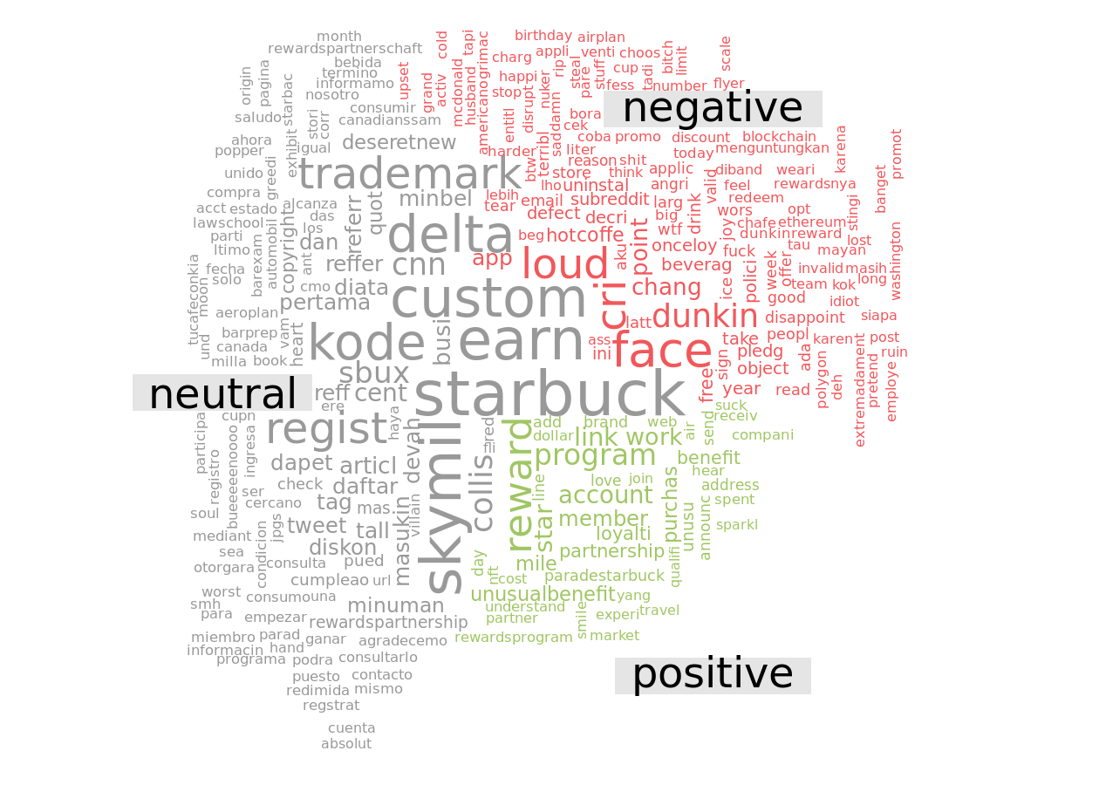
Valence word cloud

Slide 88
Emotion analysis

Slide 89
Emotion repartition
 | Posts count | Relative posts count
Total | 903.00 | 100%
anger | 91.03 | 10%
anticipation | 127.20 | 14%
disgust | 70.01 | 8%
fear | 89.28 | 10%
joy | 114.53 | 13%
sadness | 90.70 | 10%
surprise | 73.18 | 8%
trust | 247.06 | 27%
The number of posts that fall into different emotion categories summarized by their absolute and relative values. If a post has multiple emotions, then it is equally divided among those emotions.

Slide 90

Emotion histogram
The emotion histogram indicates the number of posts by their emotion.

Slide 91

Emotion distribution without uncategorized posts
Graphic summary of the relative sizes of the number of posts classified by emotion after ignoring uncategorized posts.

Slide 92

Emotion word cloud
Even if a post has multiple emotions its words will be shown only in one of those emotions.

Slide 93

Distribution of Universal Parts of Speech Tags

Slide 94
Tweets – Starbucks Robot

Slide 95
Tweets used in the analysis (excerpt)
 | Date | Source | Tweet
1 | 2022-10-13 | Twitter Web App | Win a #Starbucks Gift Card! #Giveaway __Retweet To Enter: https://t.co/vqY3WNtAew__#robot #roc #rouen #rspatial #rtf #s66rt #saone #sarsAlert #savefallguys #sculpture #selfcare #sgc #shitcamp #smallstreamer #socialmedia #stream #streamer #streamers #support @stream_caster https://t.co/Wf4p4YQUbQ
2 | 2022-10-12 | Twitter for iPhone | Today’s robot delivery - Starbucks #china #lockdown #shanghai #covid https://t.co/y5UpYOVRlj
3 | 2022-10-12 | Twitter for iPad | @gammodm One step at a time._1. Now… AI takes your order_2. 2 years out .. Robotics makes your drinks _3. 2 more years out… Robot delivers your drink_4. Starbucks has one employee.. Howard Shultz and he counts his money._5. Humans become obsolete in most of fast serve restaurants
4 | 2022-10-11 | IFTTT | Bloomberg - Are you a robot? https://t.co/s5tSoufqQs
5 | 2022-10-11 | Twitter for iPhone | The music at Starbucks is suspiciously similar to my playlists that I frequently augment using the Spotify algorithm. __Our robot overlords are trying to pacify us with Mellow Gold classics to make it easier for them to take over the world. 😳
6 | 2022-10-11 | Serval ♥ | imagine if you had the same order at starbucks
7 | 2022-10-10 | Twitter for iPhone | I’m an important person with a speaking role on this call, here let me talk ROBOT VOICE. DISCONNECT. JITTER. AIRPORT NOISE. COSTCO NOISE. I’M A BARISTA AT STARBUCKS RIGHT NOW. Yea. Thanks for giving us your time and attention!
8 | 2022-10-10 | Twitter Web App | @kangawa_tokyo @_sn_n Always! If it weren't for a handful of pot-smoking environmentalists, we'd all be millionaires with flying cars and nuclear robot servants, instead of working shifts at Starbucks and paying sky-high rent to Megacorp Landlord Inc. Damn hippies.
9 | 2022-10-07 | Twitter Web App | @misotrasvidas @egarciagarcia No gravamos el trabajo, gravamos el incremento de patrimonio, y estamos fallando. No tiene sentido gravar un robot. Tiene sentido que Starbucks pague muchos más impuestos.
10 | 2022-10-07 | Twitter Web App | @misotrasvidas @egarciagarcia En realidad el trato de un humano en un Starbucks no es tan distinto al de una máquina. La clave de esto es si vamos a poner impuestos reales a los beneficios, no tanto si hay impuestos al 'robot'. Con esos impuestos se puede pagar a mucha gente porque hagan trabajos humanos.
For full listing of tweets, use Excel version of output.

Slide 96
Word cloud

Slide 97

Word cloud
The word cloud represents the most frequently used words inside the corpus of texts provided. The bigger a word appears, the larger the number of times it occurs in the text corpus.

Slide 98

Word cloud without stemming
The word cloud represents the most frequently used words inside the corpus of texts provided. The bigger a word appears, the larger the number of times it occurs in the text corpus.

Slide 99
Valence analysis

Slide 100
Valence repartition
 | Posts count | Relative posts count
Total | 12 | 100%
negative | 4 | 33%
neutral | 4 | 33%
positive | 4 | 33%
The number of posts that fall into different valence categories summarized by their absolute and relative values.

Slide 101

Valence histogram
The valence histogram indicates the number of posts by their valence.

Slide 102

Valence distribution without uncategorized posts
Graphic summary of the relative sizes of the number of posts classified by valence after ignoring posts that could not be categorized (i.e., neutral posts).

Slide 103

Post valence ratio
The post valence ratio graph indicates the daily average number of positive posts. The blue smoothing line helps visualize the trend.

Slide 104

Valence word cloud

Slide 105
Emotion analysis

Slide 106
Emotion repartition
 | Posts count | Relative posts count
Total | 12.00 | 100%
anger | 0.96 | 8%
anticipation | 3.79 | 32%
disgust | 1.29 | 11%
fear | 1.29 | 11%
joy | 1.96 | 16%
sadness | 0.63 | 5%
surprise | 0.96 | 8%
trust | 1.13 | 9%
The number of posts that fall into different emotion categories summarized by their absolute and relative values. If a post has multiple emotions, then it is equally divided among those emotions.

Slide 107

Emotion histogram
The emotion histogram indicates the number of posts by their emotion.

Slide 108

Emotion distribution without uncategorized posts
Graphic summary of the relative sizes of the number of posts classified by emotion after ignoring uncategorized posts.

Slide 109

Emotion word cloud
Even if a post has multiple emotions its words will be shown only in one of those emotions.

Slide 110

Distribution of Universal Parts of Speech Tags

Slide 111
Tweets – Café X

Slide 112
Tweets used in the analysis (excerpt)
 | Date | Source | Tweet
1 | 2022-10-14 | Shopee_TH | ขาย พวงกุญแจอะคริลิค Ensemble Stars x Animate cafe *สินค้าเป็นของมือสอง* ในราคา ฿149 - ฿199 ใน #ShopeeTH ตอนนี้! https://t.co/h9vduBh7gX__#ตลาดนัดอนิเมะ #ตลาดนัดอนิเมะรวมด้อม #ตลาดนัดอันสึตะ #ตลาดนัดensemblestars https://t.co/txqRVfDKxB
2 | 2022-10-12 | Shopee_TH | ขาย พวงกุญแจยาง - Nagisa Ran - Ensemble Stars! x Animate Cafe Heart Shaped Clear Sweets Rubber Charm ในราคา ฿169 ใน #ShopeeTH ตอนนี้! https://t.co/uJZYKcGCjW__#ตลาดนัดอนิเมะ #ตลาดนัดอนิเมะรวมด้อม #ตลาดนัดอันสึตะ #ตลาดนัดensemblestars https://t.co/eVtLOL2Eqt
3 | 2022-10-13 | Shopee_TH | ขาย พวงกุญแจยาง - Tsukasa Suou - Ensemble Stars! x Animate Cafe Heart Shaped Clear Sweets Rubber Charm ในราคา ฿169 ใน #ShopeeTH ตอนนี้! https://t.co/1elTFYLS1n__#ตลาดนัดอนิเมะ #ตลาดนัดอนิเมะรวมด้อม #ตลาดนัดอันสึตะ #ตลาดนัดensemblestars https://t.co/HLV9TgT04Y
4 | 2022-10-12 | Shopee_TH | ขาย พวงกุญแจยาง - Nagisa Ran - Ensemble Stars! x Animate Cafe Heart Shaped Clear Sweets Rubber Charm ในราคา ฿169 ใน #ShopeeTH ตอนนี้! https://t.co/xspwJYdjZu__#ตลาดนัดอนิเมะ #ตลาดนัดอนิเมะรวมด้อม #ตลาดนัดอันสึตะ #ตลาดนัดensemblestars https://t.co/2UyNVcQcW4
5 | 2022-10-11 | Shopee_TH | ขาย พวงกุญแจยาง - Nito Nazuna - Ensemble Stars! x Animate Cafe Heart Shaped Clear Sweets Rubber Charm ในราคา ฿139 ใน #ShopeeTH ตอนนี้! https://t.co/3Nq3dVB91n__#ตลาดนัดอนิเมะ #ตลาดนัดอนิเมะรวมด้อม #ตลาดนัดensemblestars #ตลาดนัดอันสึตะ https://t.co/9B0BIg4VZ8
6 | 2022-10-12 | Shopee_TH | ขาย พวงกุญแจยาง - Tsukasa Suou - Ensemble Stars! x Animate Cafe Heart Shaped Clear Sweets Rubber Charm ในราคา ฿169 ใน #ShopeeTH ตอนนี้! https://t.co/Wo9F29u8Ro__#ตลาดนัดอนิเมะ #ตลาดนัดอนิเมะรวมด้อม #ตลาดนัดอันสึตะ #ตลาดนัดensemblestars https://t.co/8aoU8UAOK4
7 | 2022-10-14 | Twitter Web App | ('2022-10-14 11:41:31',);[판매중] BMW E53 X5 3.0; , https://t.co/QSZhWYmOcL, 띠띠빵빵 :: 중고차 직거래 장터 : 네이버 카페 : 아스트로팔
8 | 2022-10-13 | Twitter Web App | ('2022-10-14 08:21:02',);[판매중] bmw x6 m50d 18년 87,000k 판매합니다; , https://t.co/0freP5NZze, 띠띠빵빵 :: 중고차 직거래 장터 : 네이버 카페 : 은둔스
9 | 2022-10-11 | Twitter Web App | ('2022-10-12 02:00:49',);[판매중] BMW X5 급매 370만원 상태좋음.; , https://t.co/SlTmmLc9FP, 띠띠빵빵 :: 중고차 직거래 장터 : 네이버 카페 : 블라디보스톡
10 | 2022-10-13 | Twitter Web App | ('2022-10-13 12:30:02',);[판매중] Bmw X5 e53; , https://t.co/hwQYYLACpi, 띠띠빵빵 :: 중고차 직거래 장터 : 네이버 카페 : 대전 훈남이2

Slide 113
Tweets used in the analysis (...)
For full listing of tweets, use Excel version of output.

Slide 114
Word cloud

Slide 115

Word cloud
The word cloud represents the most frequently used words inside the corpus of texts provided. The bigger a word appears, the larger the number of times it occurs in the text corpus.

Slide 116

Word cloud without stemming
The word cloud represents the most frequently used words inside the corpus of texts provided. The bigger a word appears, the larger the number of times it occurs in the text corpus.

Slide 117
Valence analysis

Slide 118
Valence repartition
 | Posts count | Relative posts count
Total | 1 000 | 100%
negative | 198 | 20%
neutral | 508 | 51%
positive | 294 | 29%
The number of posts that fall into different valence categories summarized by their absolute and relative values.

Slide 119

Valence histogram
The valence histogram indicates the number of posts by their valence.

Slide 120

Valence distribution without uncategorized posts
Graphic summary of the relative sizes of the number of posts classified by valence after ignoring posts that could not be categorized (i.e., neutral posts).

Slide 121

Post valence ratio
The post valence ratio graph indicates the daily average number of positive posts. The blue smoothing line helps visualize the trend.

Slide 122

Valence word cloud

Slide 123
Emotion analysis

Slide 124
Emotion repartition
 | Posts count | Relative posts count
Total | 1 000.00 | 100%
anger | 123.55 | 12%
anticipation | 134.13 | 13%
disgust | 98.03 | 10%
fear | 105.78 | 11%
joy | 168.70 | 17%
sadness | 127.07 | 13%
surprise | 97.10 | 10%
trust | 145.63 | 15%
The number of posts that fall into different emotion categories summarized by their absolute and relative values. If a post has multiple emotions, then it is equally divided among those emotions.

Slide 125

Emotion histogram
The emotion histogram indicates the number of posts by their emotion.

Slide 126

Emotion distribution without uncategorized posts
Graphic summary of the relative sizes of the number of posts classified by emotion after ignoring uncategorized posts.

Slide 127

Emotion word cloud
Even if a post has multiple emotions its words will be shown only in one of those emotions.

Slide 128

Distribution of Universal Parts of Speech Tags

Slide 129
Tweets - @getcafex

Slide 130
Tweets used in the analysis (excerpt)
 | Date | Source | Tweet
1 | 2022-09-24 | Twitter for iPhone | @Marco_mmabjj The same thing that a barista who operates a bunch of machines at a cafe would do.
2 | 2022-09-24 | Twitter for iPhone | @alexgrenier The robot allows for more creative drinks that require multiple machines to build but it’s also just fun 🙆‍♂️
3 | 2022-09-24 | Twitter for iPhone | We’re shipping robotic coffee bars to B2B customers! This one’s headed to 🇩🇪 https://t.co/75Ijs7v09X
4 | 2022-09-06 | Twitter for iPhone | @spencercamp @pitdesi @Jason Our new pumpkin chai cold brew is really great 😊 https://t.co/zeYIermhfi
5 | 2022-08-09 | Twitter for iPhone | Bought coffee at the airport made by a robot with a point of sale displaying BAYC #3679 paid with @TheDogeCard and earned 2.35 Dogecoin…I love this crazy world 🌎 ❤️😜 https://t.co/9O8OA15PIM
6 | 2022-06-30 | Twitter for iPhone | @Jason https://t.co/uBw7IipZXS
7 | 2022-06-04 | Twitter for iPhone | @RobMeyerson D-Bot. Oh wait…
8 | 2022-05-17 | Twitter for iPhone | @prachiniksingh Sorry about that! We have proceeded a refund.
9 | 2022-04-15 | Twitter for iPhone | @crystalpoppinn Thanks!
10 | 2022-04-15 | Twitter for iPhone | Alright the matcha latte made by a cute robot arm at @getcafex is pretty damn good

Slide 131
Tweets used in the analysis (...)
For full listing of tweets, use Excel version of output.

Slide 132
Word cloud

Slide 133

Word cloud
The word cloud represents the most frequently used words inside the corpus of texts provided. The bigger a word appears, the larger the number of times it occurs in the text corpus.

Slide 134

Word cloud without stemming
The word cloud represents the most frequently used words inside the corpus of texts provided. The bigger a word appears, the larger the number of times it occurs in the text corpus.

Slide 135
Valence analysis

Slide 136
Valence repartition
 | Posts count | Relative posts count
Total | 998 | 100%
negative | 79 | 8%
neutral | 196 | 20%
positive | 723 | 72%
The number of posts that fall into different valence categories summarized by their absolute and relative values.

Slide 137

Valence histogram
The valence histogram indicates the number of posts by their valence.

Slide 138

Valence distribution without uncategorized posts
Graphic summary of the relative sizes of the number of posts classified by valence after ignoring posts that could not be categorized (i.e., neutral posts).

Slide 139

Post valence ratio
The post valence ratio graph indicates the daily average number of positive posts. The blue smoothing line helps visualize the trend.

Slide 140

Valence word cloud

Slide 141
Emotion analysis

Slide 142
Emotion repartition
 | Posts count | Relative posts count
Total | 998.00 | 100%
anger | 98.23 | 10%
anticipation | 181.26 | 18%
disgust | 54.69 | 5%
fear | 64.21 | 6%
joy | 292.36 | 29%
sadness | 57.73 | 6%
surprise | 83.56 | 8%
trust | 165.98 | 17%
The number of posts that fall into different emotion categories summarized by their absolute and relative values. If a post has multiple emotions, then it is equally divided among those emotions.

Slide 143

Emotion histogram
The emotion histogram indicates the number of posts by their emotion.

Slide 144

Emotion distribution without uncategorized posts
Graphic summary of the relative sizes of the number of posts classified by emotion after ignoring uncategorized posts.

Slide 145

Emotion word cloud
Even if a post has multiple emotions its words will be shown only in one of those emotions.

Slide 146

Distribution of Universal Parts of Speech Tags

